Slide 1
APPROVED BY AICTE, NEW DELHI
&
PERMANENTLY AFFILIATED TO ANNA UNIVERSITY, CHENNAI

Slide 2
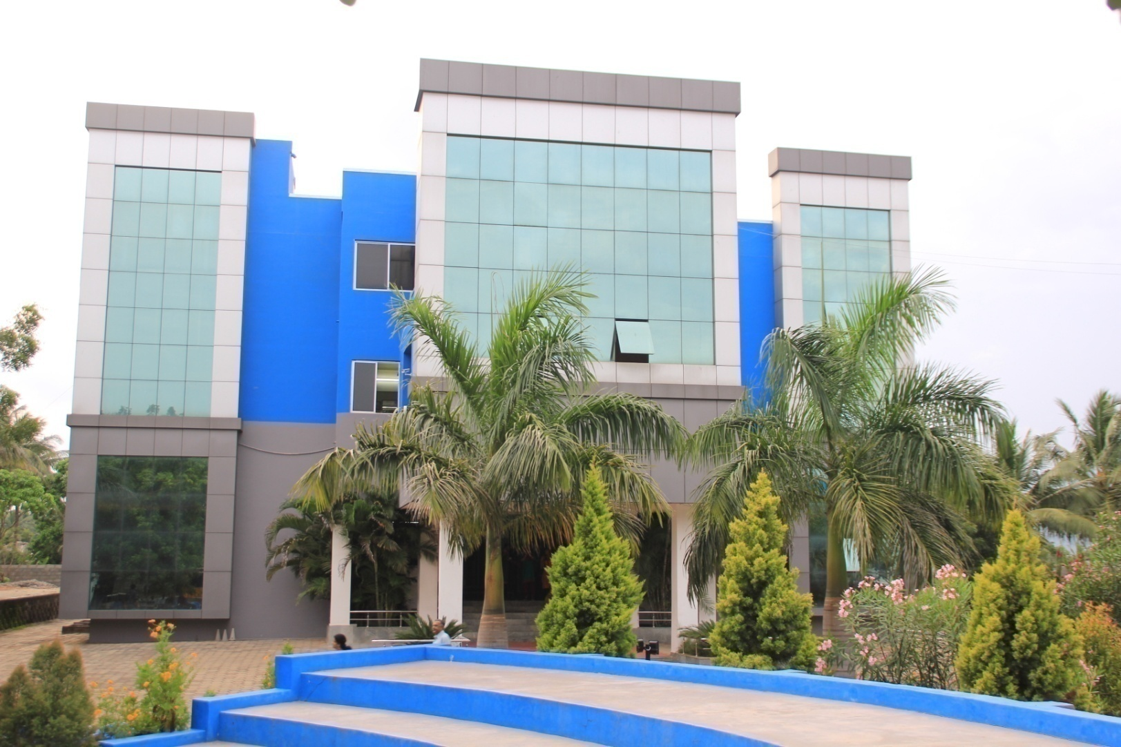
Dear Chairman &learned panel members,
Happy Valley Business School welcomes you all.
With your permission, let me present the journey of Happy Valley Business School so far

Slide 3
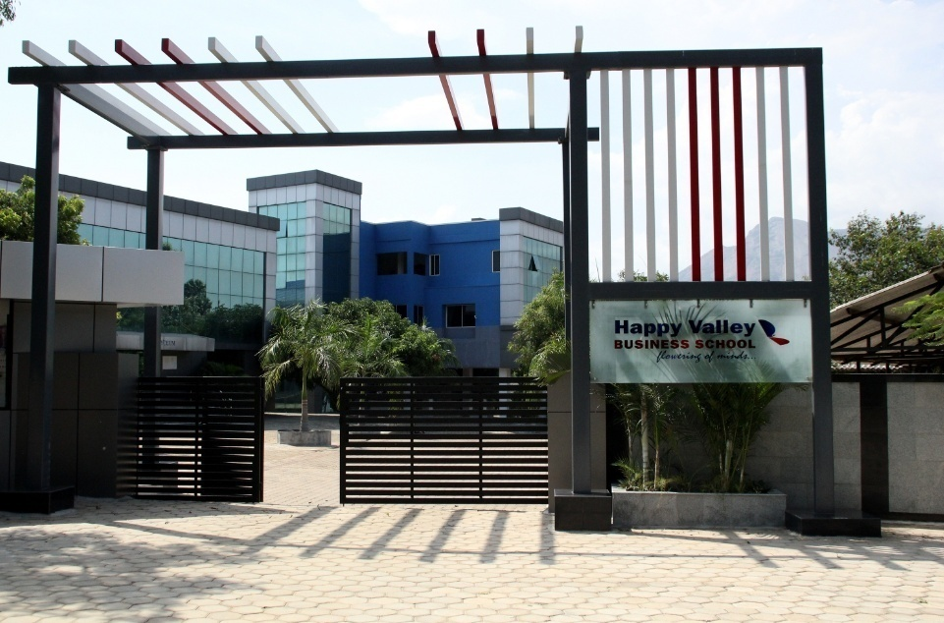
Happy Valley Business School
A “small institution with BIG dreams” started in 2007
Initial student strength :60

Slide 4
Vision
“To achieve excellence in providing quality education for creating a knowledge community.”

Slide 5
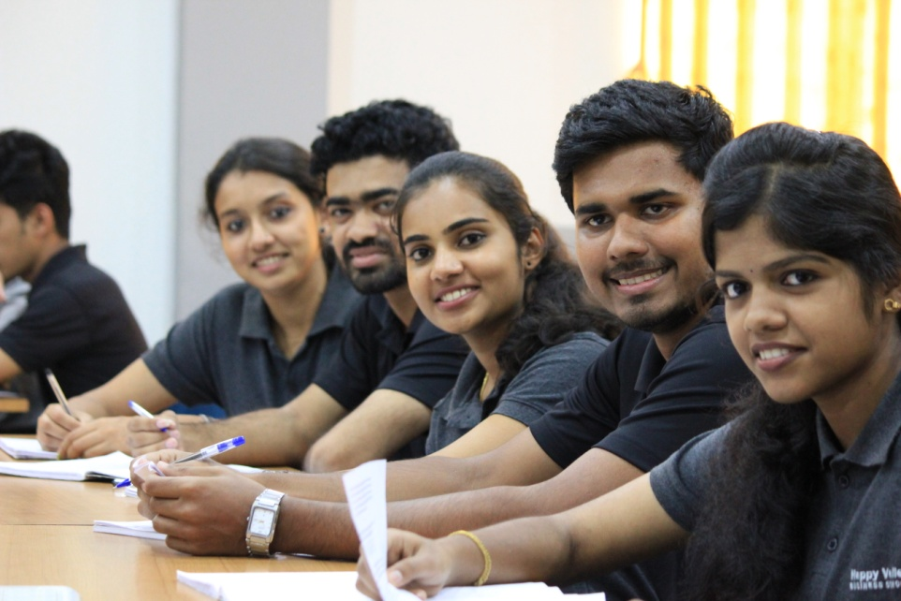
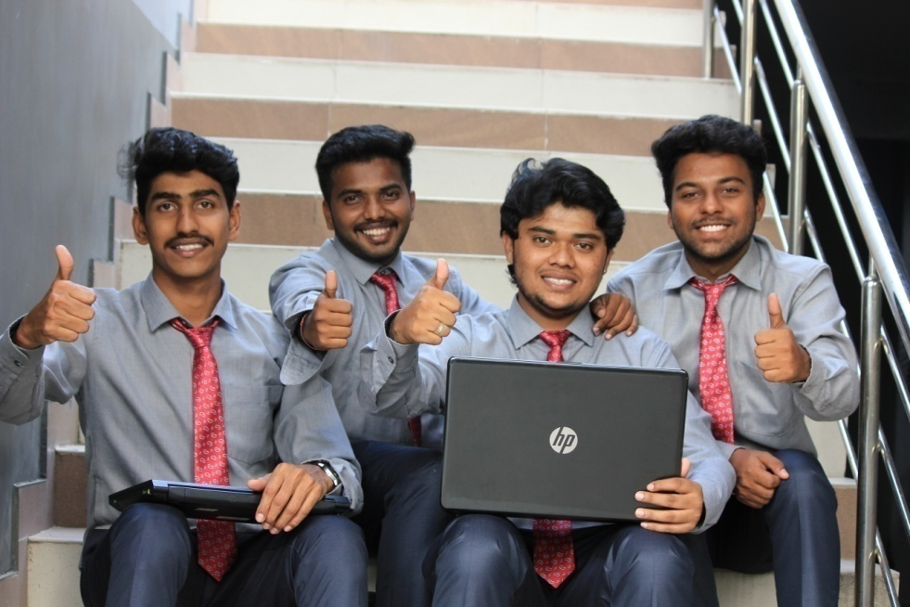
Mission
The institution continuously strives to foster excellence in students through:
Helping them learn the science of management in classrooms & reinforcing concepts through experiential learning, coupled with learning the art of management through corporate interactions.
Exposure to cross-cultural environments.
Unwavering focus on merit with ethics.

Slide 6
HAPPY VALLEY THROUGH THE YEARS!
………………………………………………………...Beginning 2007

Slide 7
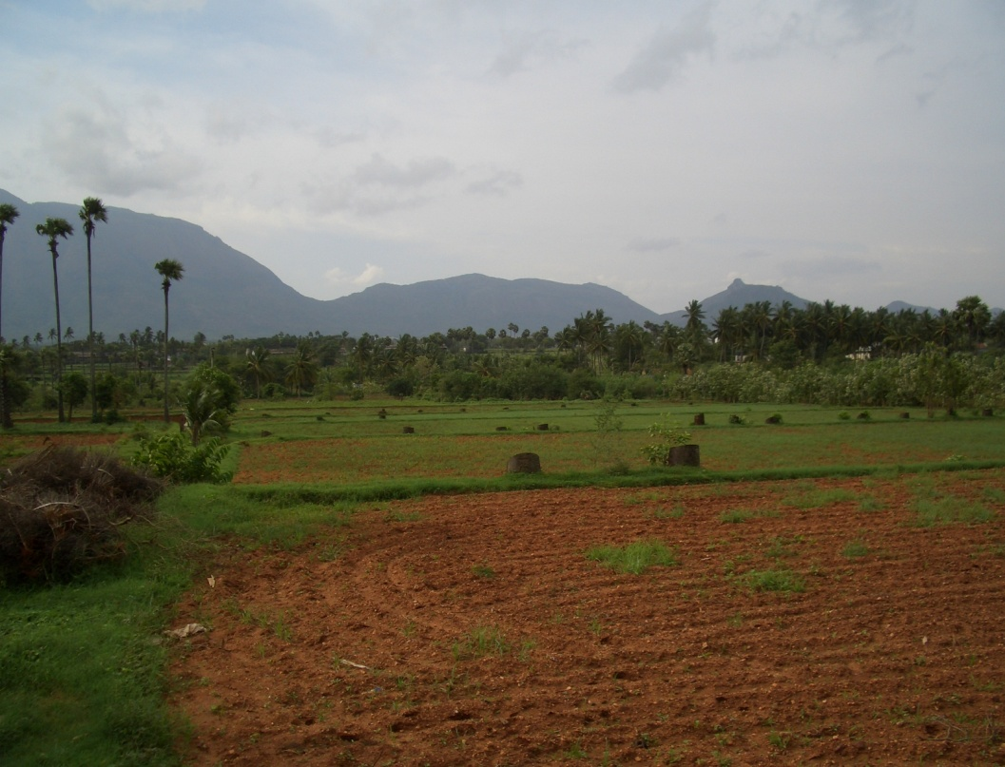
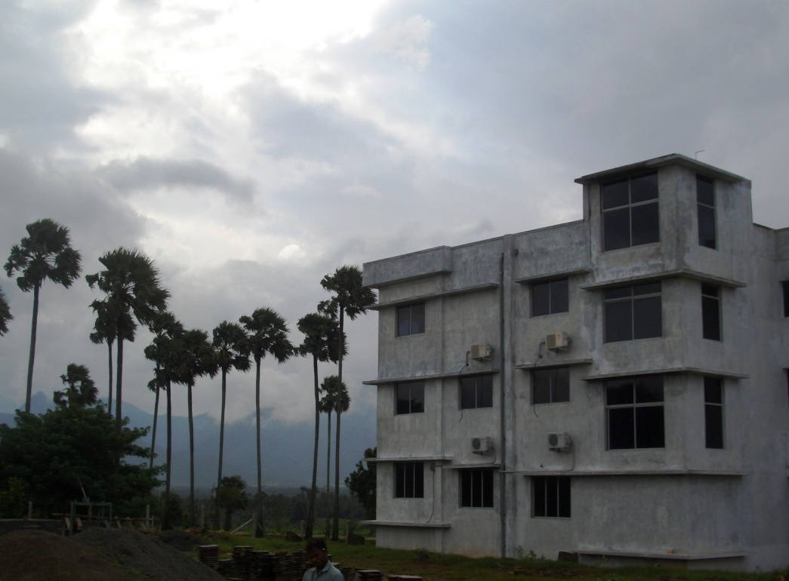
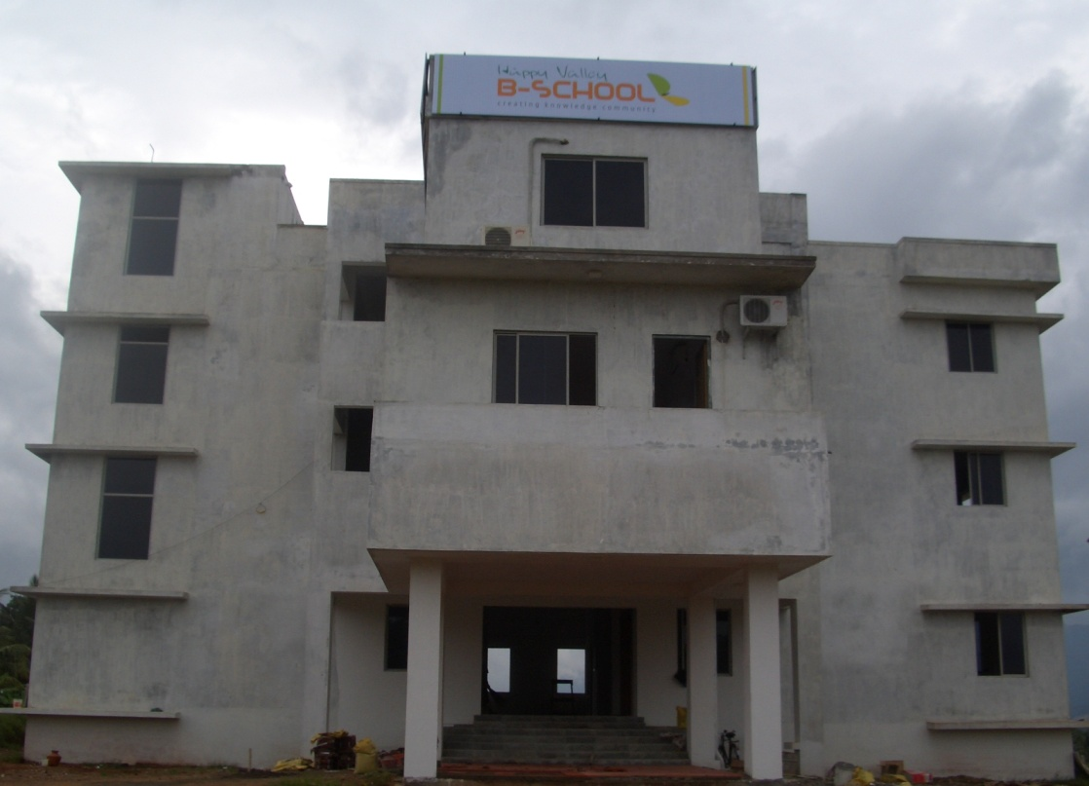
SANCTIONED STRENGTH 60

Slide 8
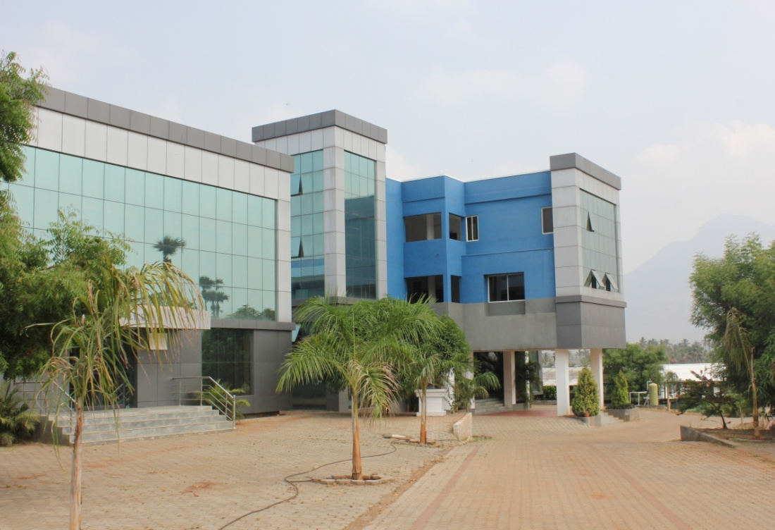
2012 ( Student intake increased to 120)

Slide 9
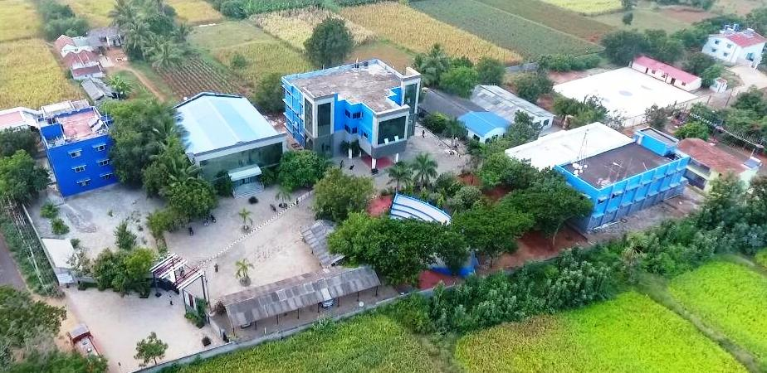
2016- GRANT OF PERMANENT AFFILIATION TO ANNA UNIVERSITY, CHENNAI

Slide 10
GOVERNANCE

Slide 12
Governing Council
The Board of Directors are from different walks of life.
After establishing the Happy Valley Charitable Trust in 2006, the Board gave the Mission & Vision for the institution and asked the professionals to accomplish them.
Board meets once a year and the CEO reports the progress to the Board and gets necessary feedback and directions.

Slide 13
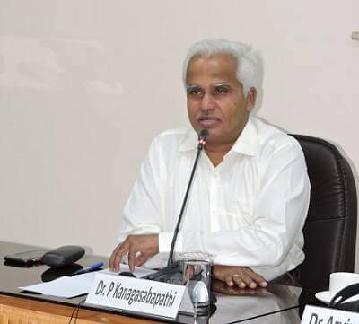
CHAIRMAN - GOVERNING COUNCIL Dr.P.Kanagasabapathy
Chairman-Indian Council of Social
Science Research, New Delhi
Director- Shipping Corporation of India
Limited

Slide 14
Governing Council Members
Sl. No. | Name | Designation
1 | Dr. P. Kanagasabapathy | Chairman, Governing Council
2 | Shri. R. Ramkutty | Member, Governing Council
3 | CA. G. Karthikeyan | Member, Governing Council
4 | Shri. Rajiv Ramaswamy | Member, Governing Council
5 | Shri. Omkar V Sankar | Member, Governing Council
6 | Dr.P.R. Muthuswamy | Member, Governing Council
7 | Dr.C. Kanagaraj | Member, Governing Council
8 | Dr.T. Bina | Member, Governing Council
9 | Dr.R. Vishal Kumar | Member, Governing Council
10 | Prof. K. Sampath Kumar | Member, Governing Council

Slide 15
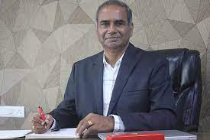
Dr.C.KANAGARAJ, CEO
FOUNDER Member OF HVBS
Industry Experience: 10 Years
Academic Experience: 23 Years
BoS Member of ANNA UNIVERSITY, Chennai , since 2007
BoS Member of Excel Group of Institutions, Namakkal District

Slide 16
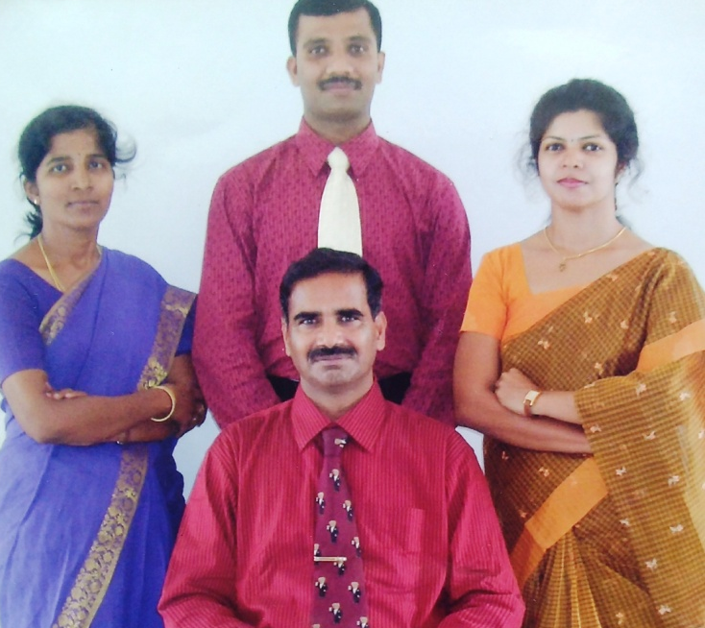
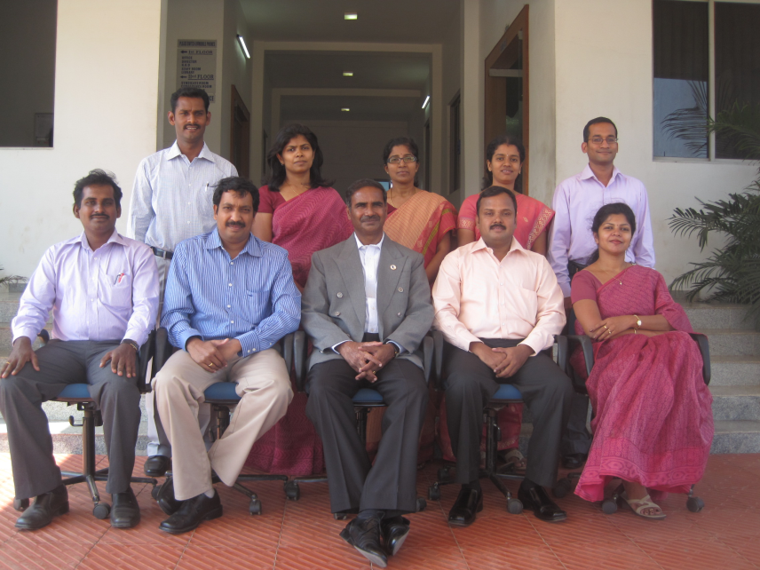
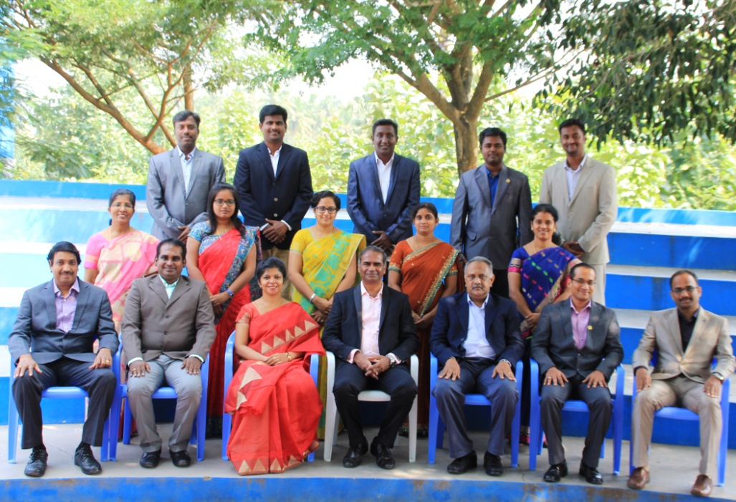
Faculty Team from 2007 -2019

Slide 17
INFRASTRUCTURE

Slide 18
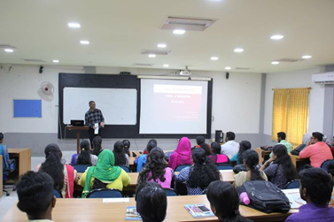
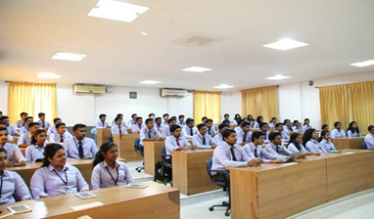
Classrooms – First Year Classrooms Gallery Type
Features
Gallery Type
Air Condition
Interactive Projector - Dell
Audio Facility
LED Lighting
Desks & Revolving Chairs
Magnetic whiteboard
Podium
Wi-fi Internet connectivity
CCTV Camera
Recording facility & OHP Projector on-demand
Name | Room Location | Carpet Area in Sq.M. | Seating Capacity
Class 1 | Academic Building | 105 | 60
Class 1 | Academic Building | 105 | 60

Slide 19
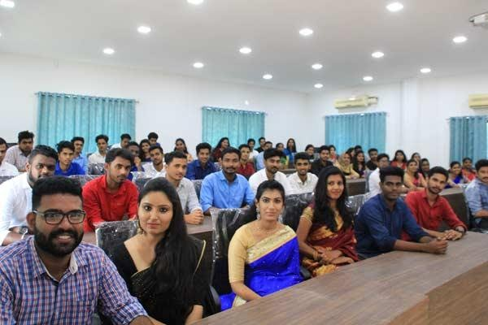
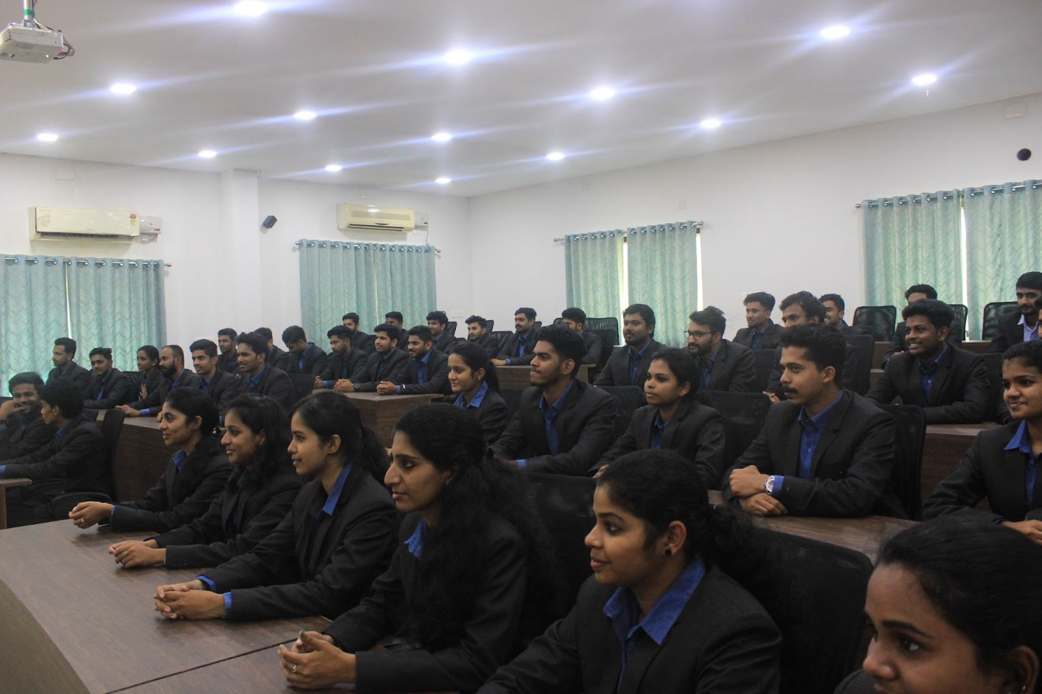
Classrooms – Second Year Classrooms Gallery Type
Features Gallery Type
Air Condition
Projector - Epson
Audio Facility
LED Lighting
Desks & Revolving Chairs
Tiles
Magnetic whiteboard
Podium
Wi-fi Internet connectivity
Recording facility & OHP Projector on-demand
Name | Room Location | Carpet Area in Sq.M. | Seating Capacity
Class 3 | Luminous Square | 106.89 | 60
Class 4 | Luminous Square | 106.89 | 60

Slide 20
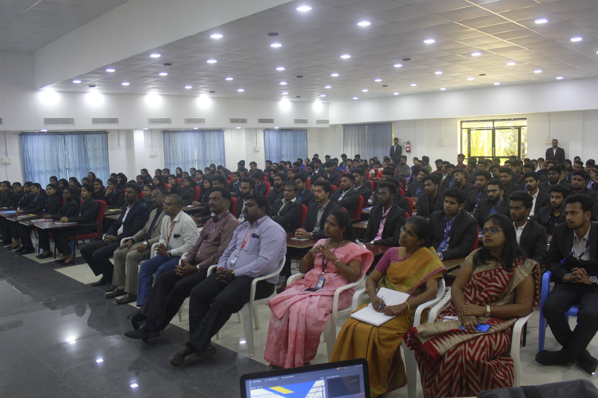
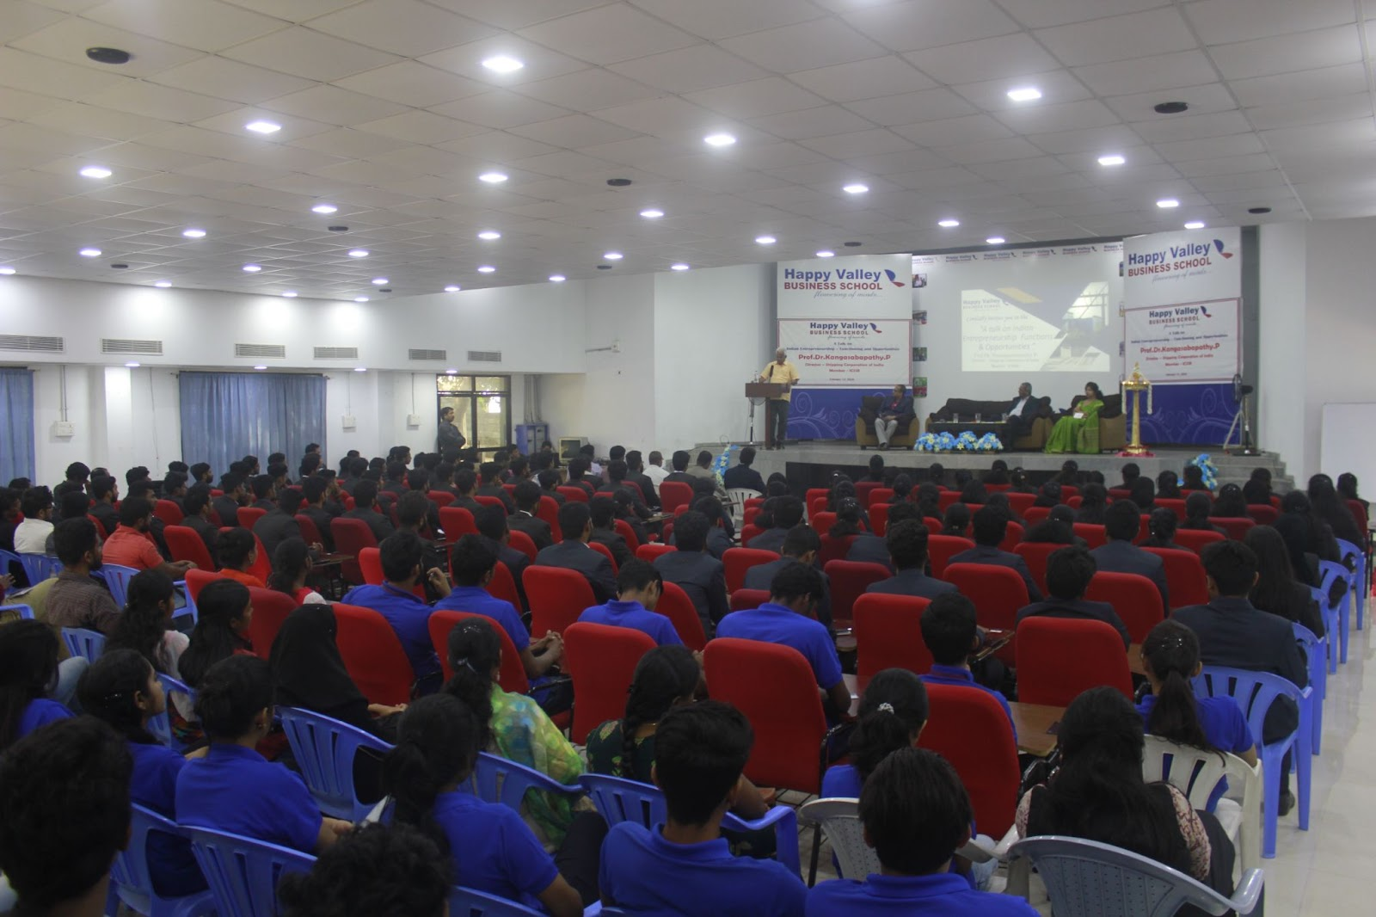
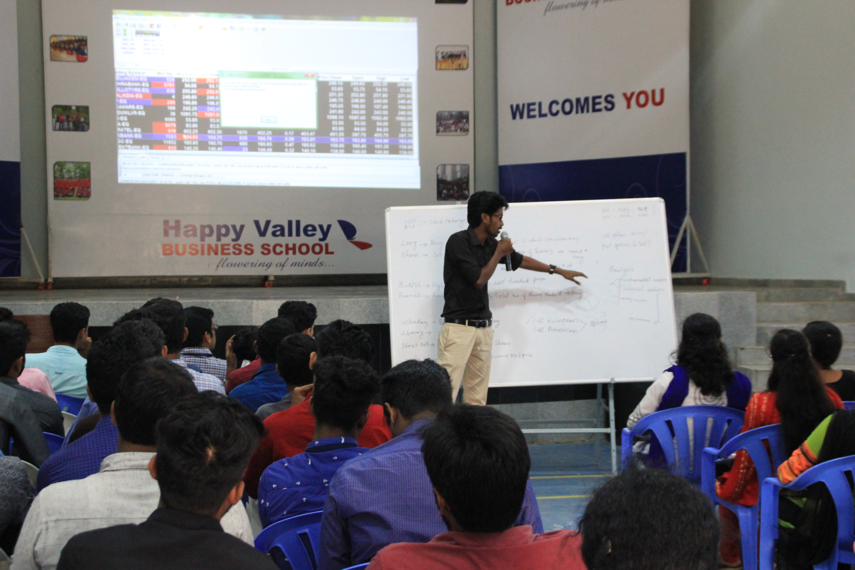
Auditorium
Name | Location | Carpet Area in Sq.M. | Seating Capacity
Lyceum | Auditorium Building | 317 | 350
Facilities
Air Condition
LED Lighting
Audio Facility/PA
Chairs with writing pad
Podium
LCD Projector
Video recording facility

Slide 21
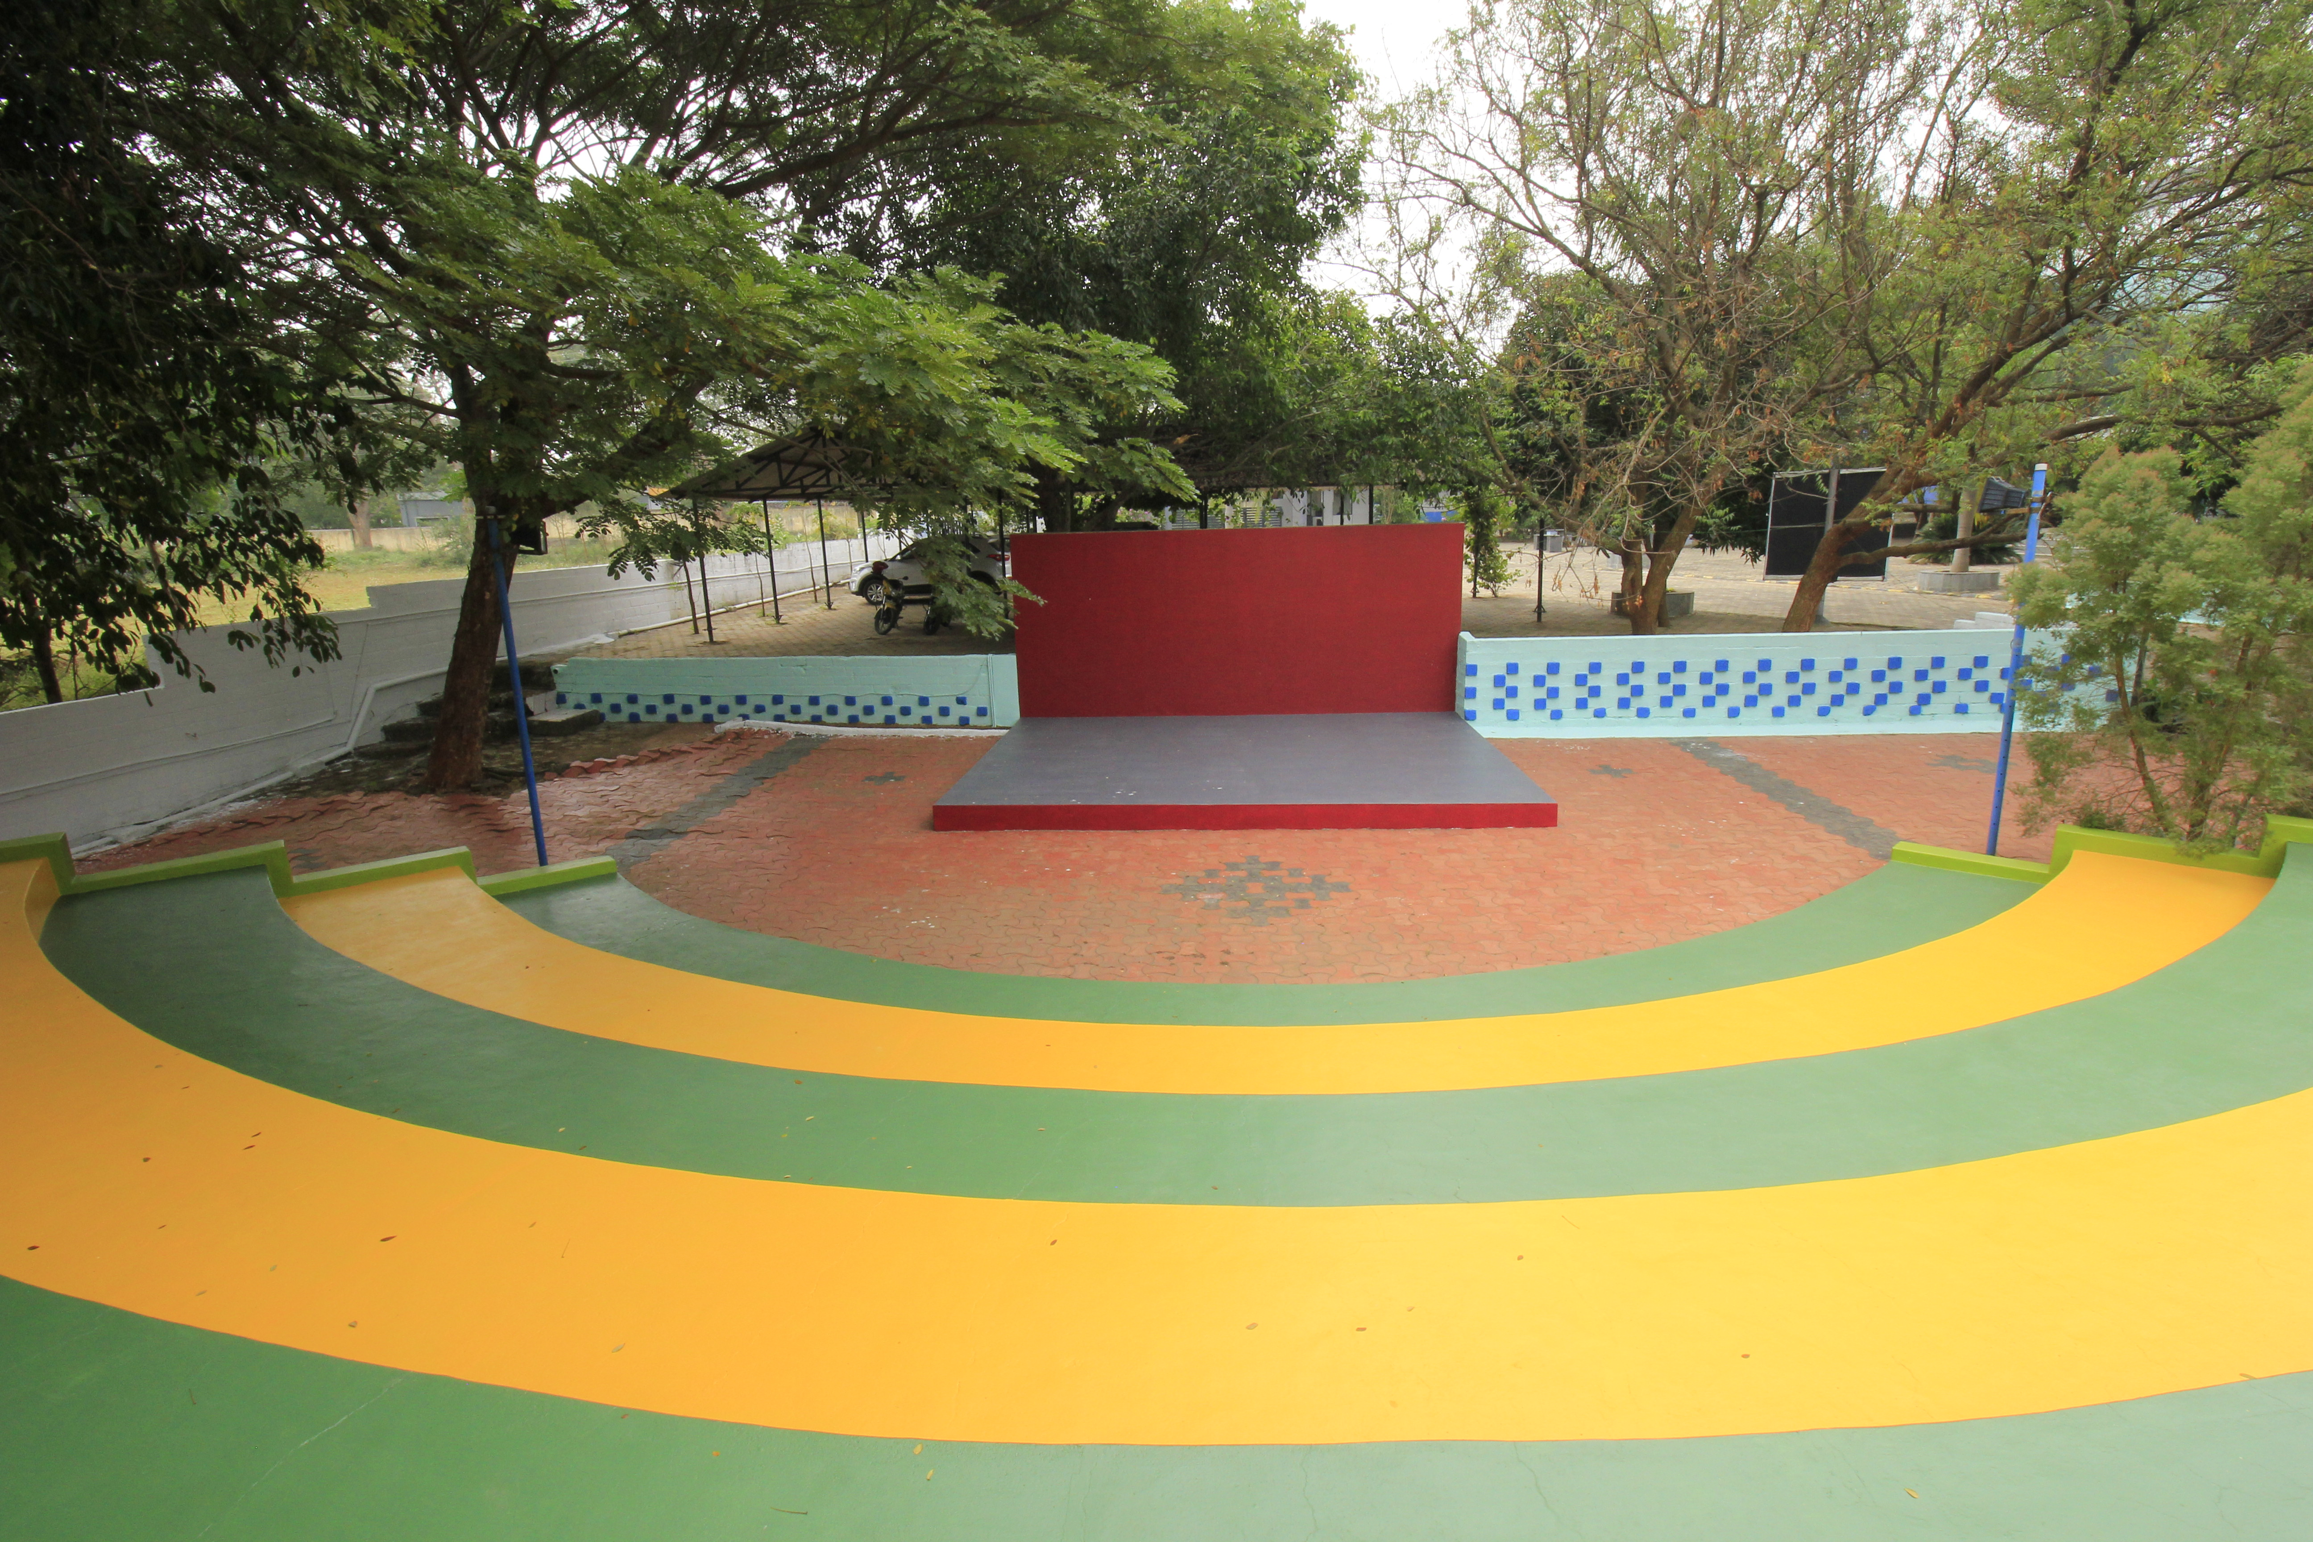
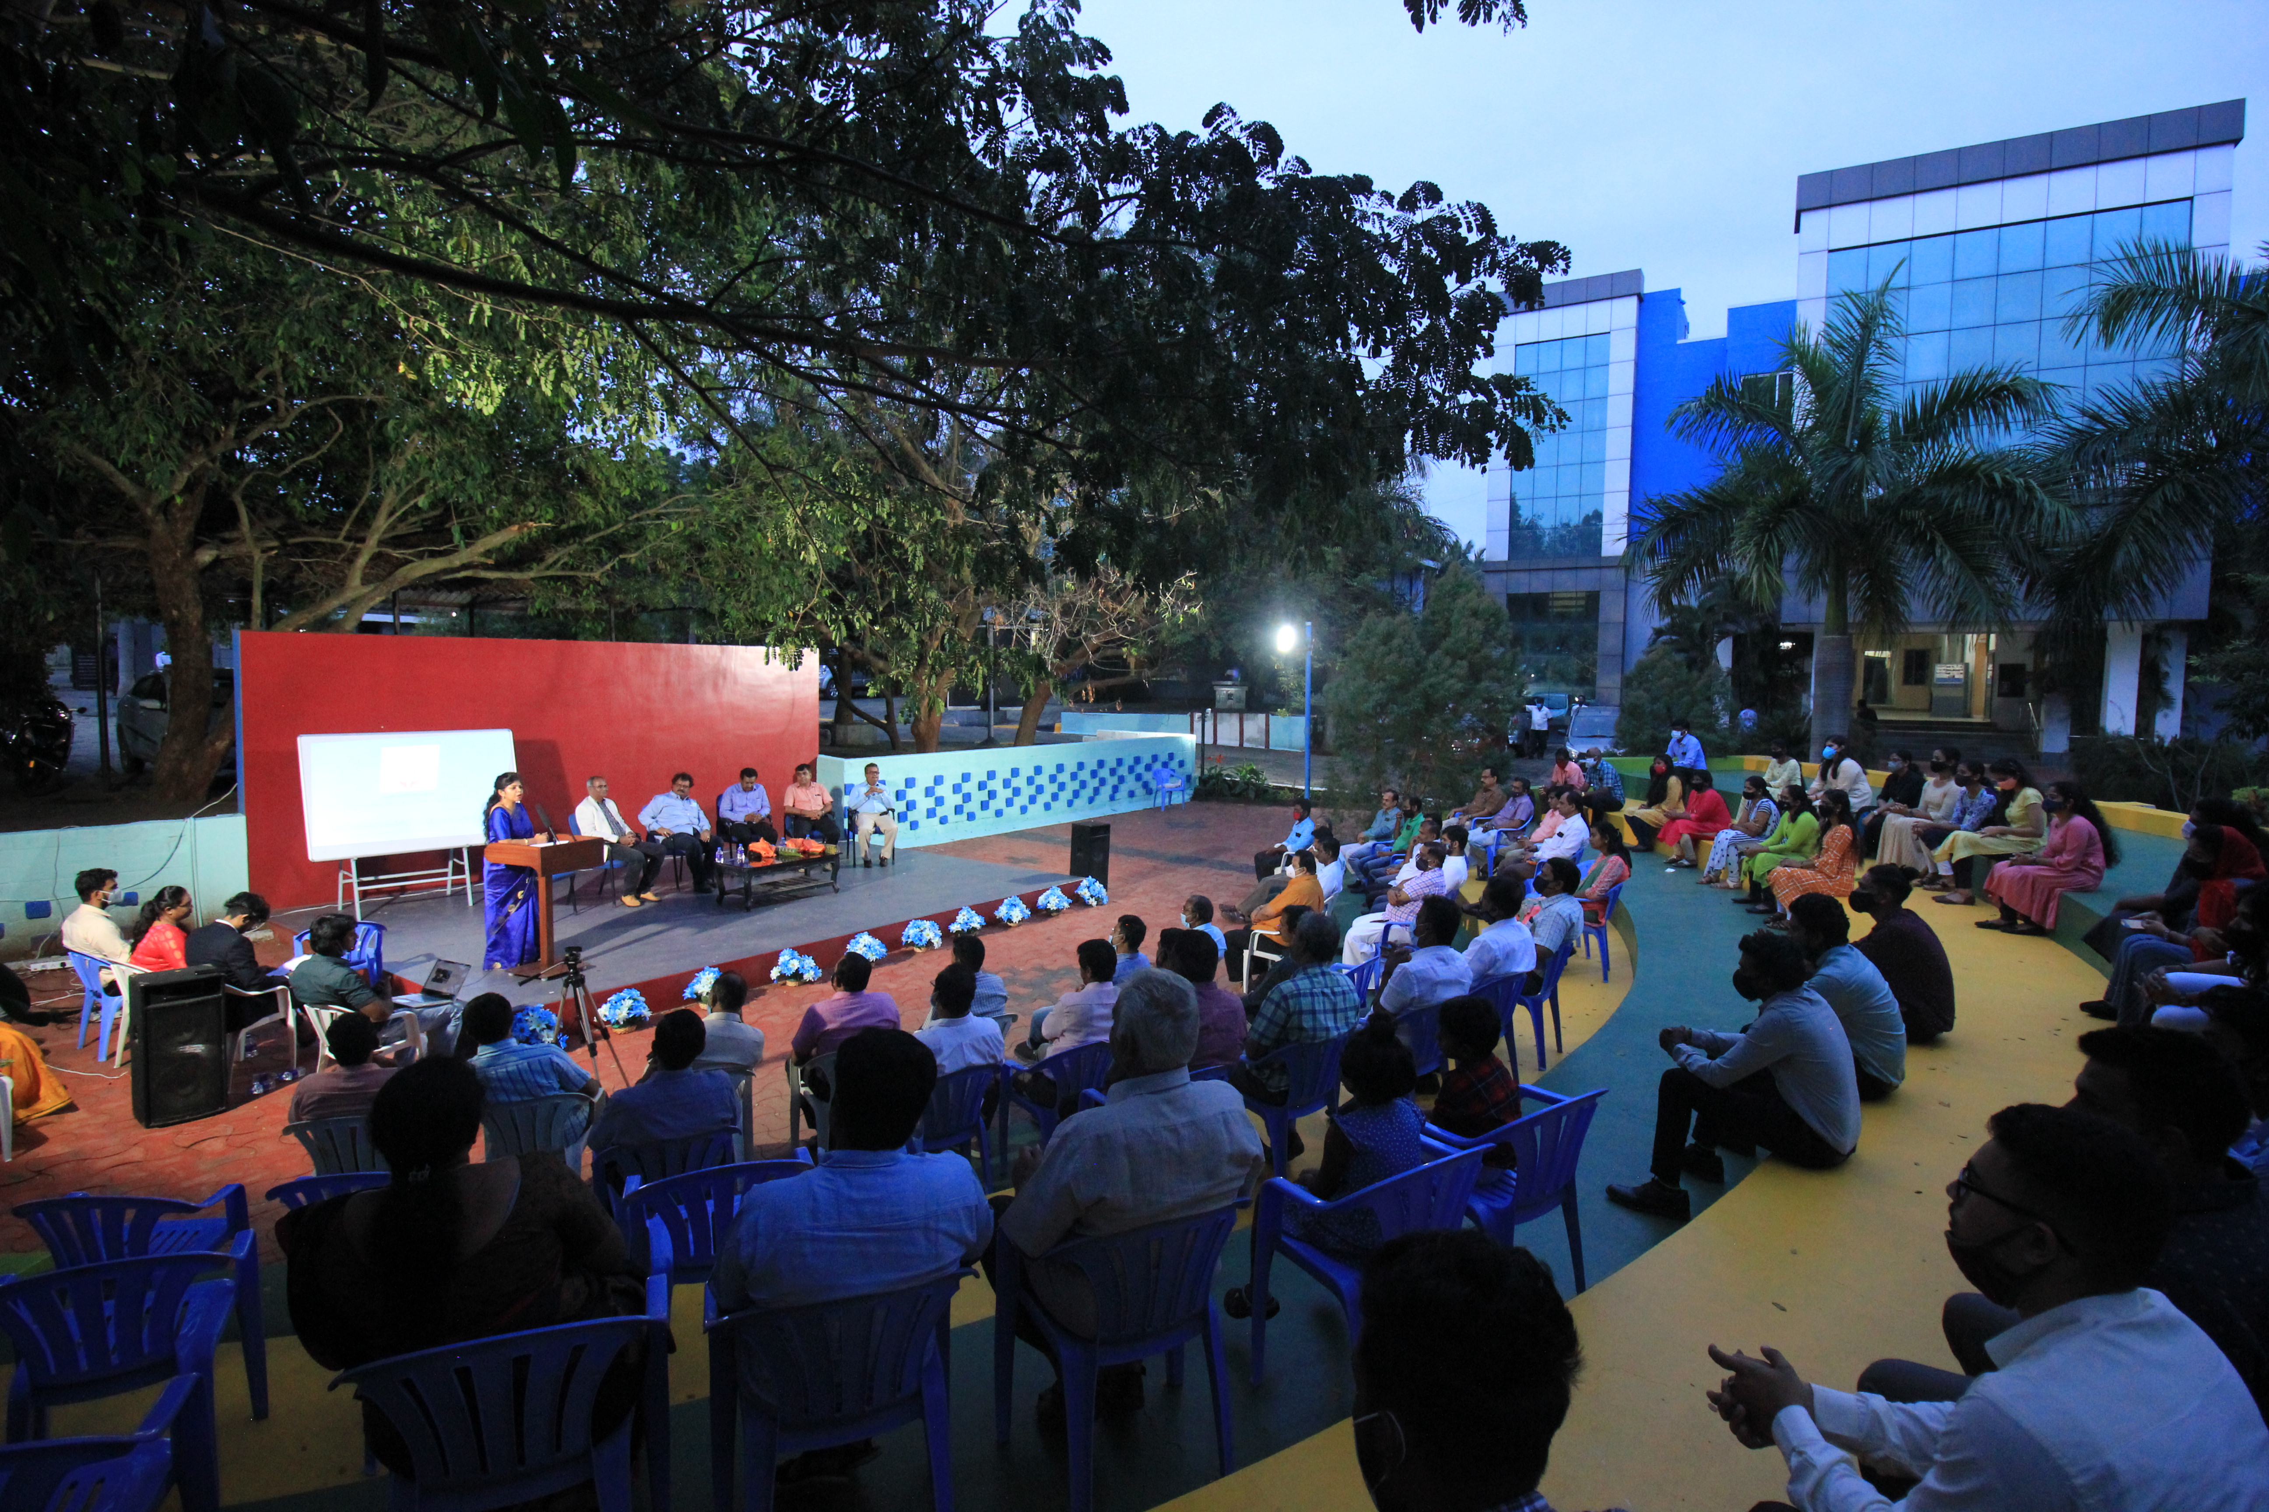
Galllery
Facilities
Lighting
Portable Audio/PA
Portable Projector
Stage
Social Distancing Ready
Outdoor activity
Name | Location | Carpet Area in Sq.M. | Seating Capacity
Symphony | Gallery - Amphitheatre | 50 x 50 | 300

Slide 22
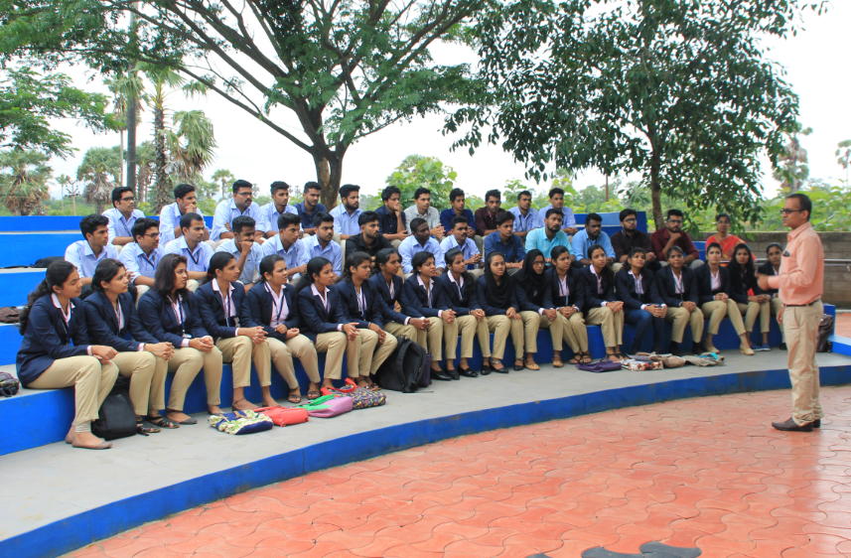
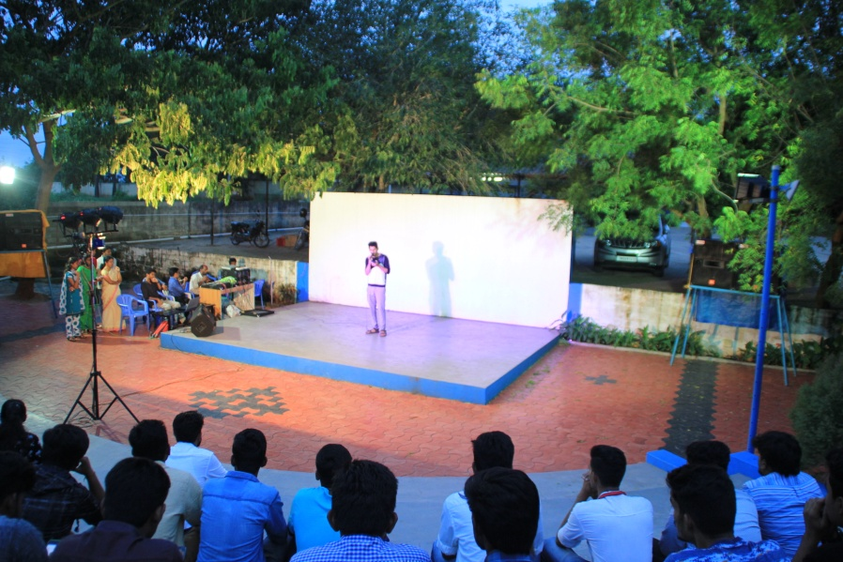
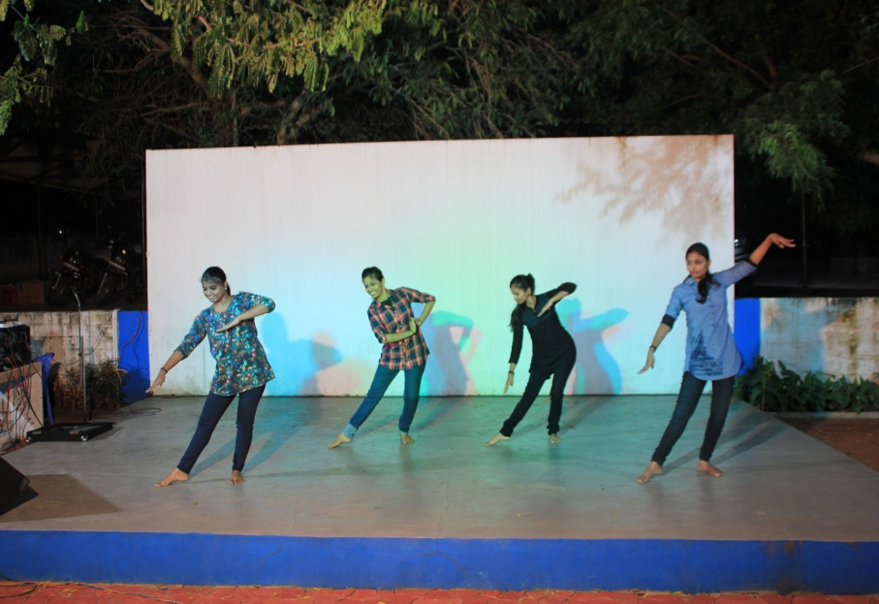
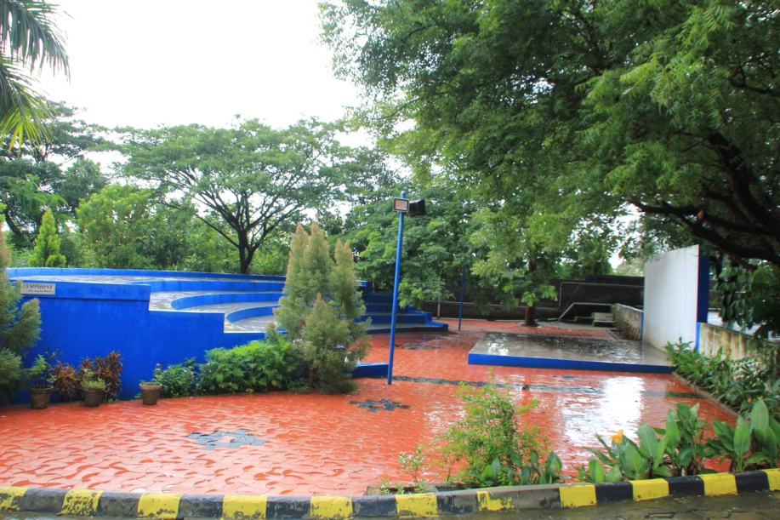
Infrastructure - Symphony
A 300 seater Amphi-theatre is available for the students to conduct learning and recreational activities.

Slide 23
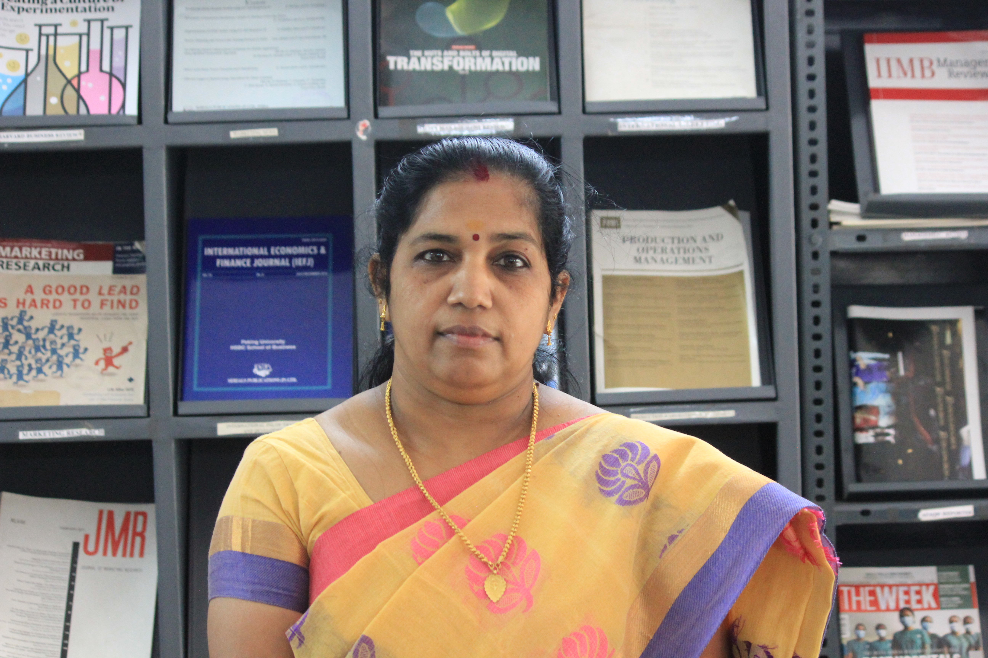
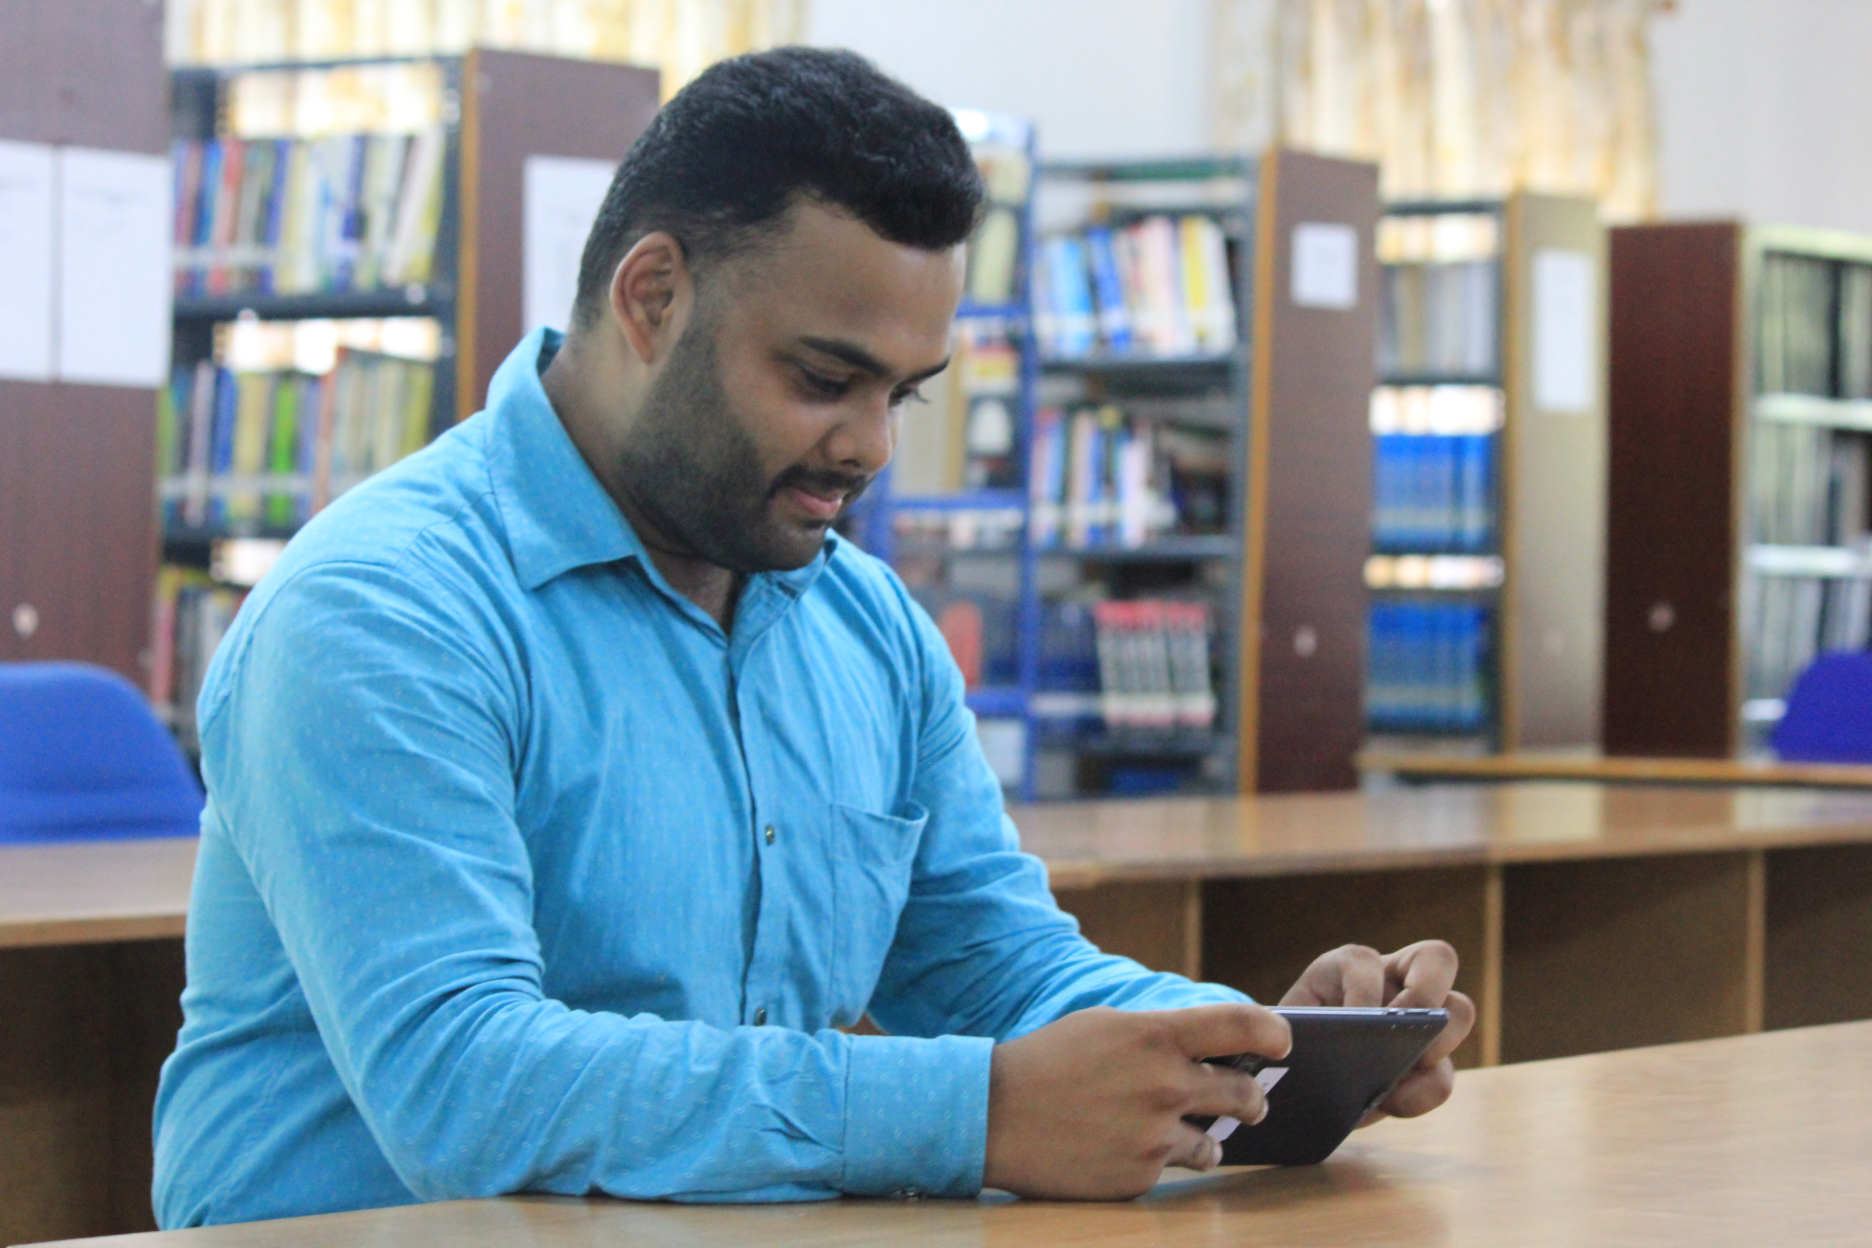
Library
Facilities
Journals - 33
International Journal – 6
E Journal – 240
Net Facility
Name | Location | Carpet Area in Sq.M. | Seating Capacity
Library | Library Building | 184 | 60
Description | Available
No. of Volumes | 7903
No. of Titles | 3510
Digital Library | 10 PCs and 10 Tabs

Slide 24
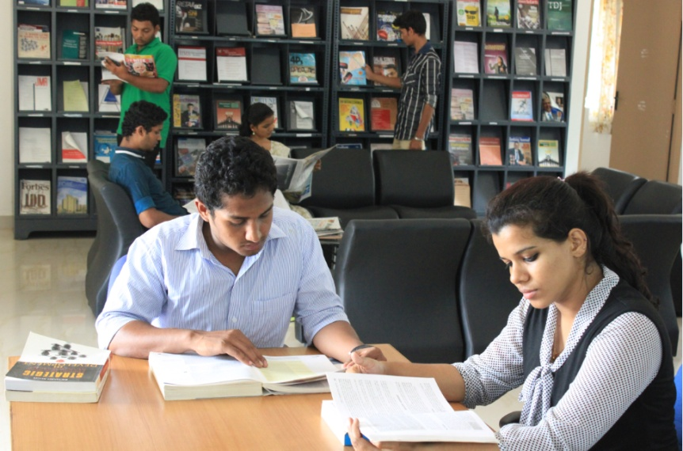
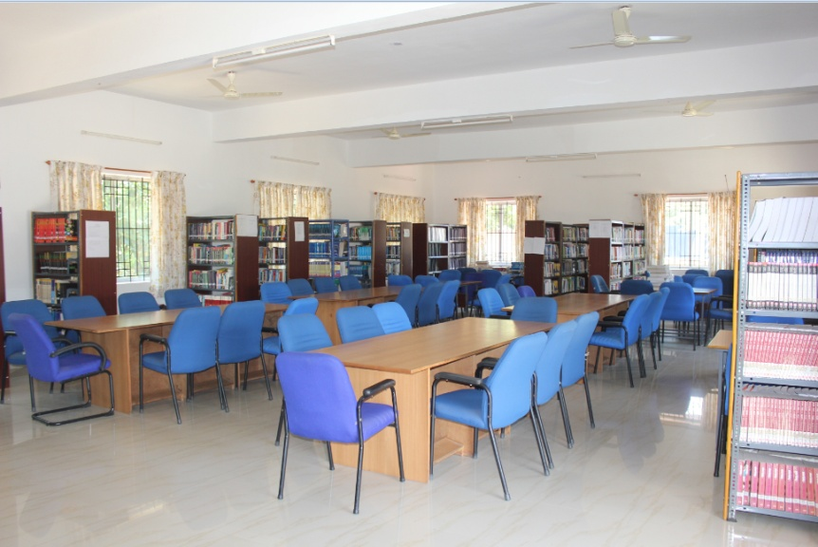
Infrastructure - Library
HVBS library is a repository of knowledge.
HVBS has a full-fledged library housed in a separate building and administered by a well-qualified librarian.
There is a digital library subscribed to Delnet.
Well maintained archives of magazines and journals.

Slide 25
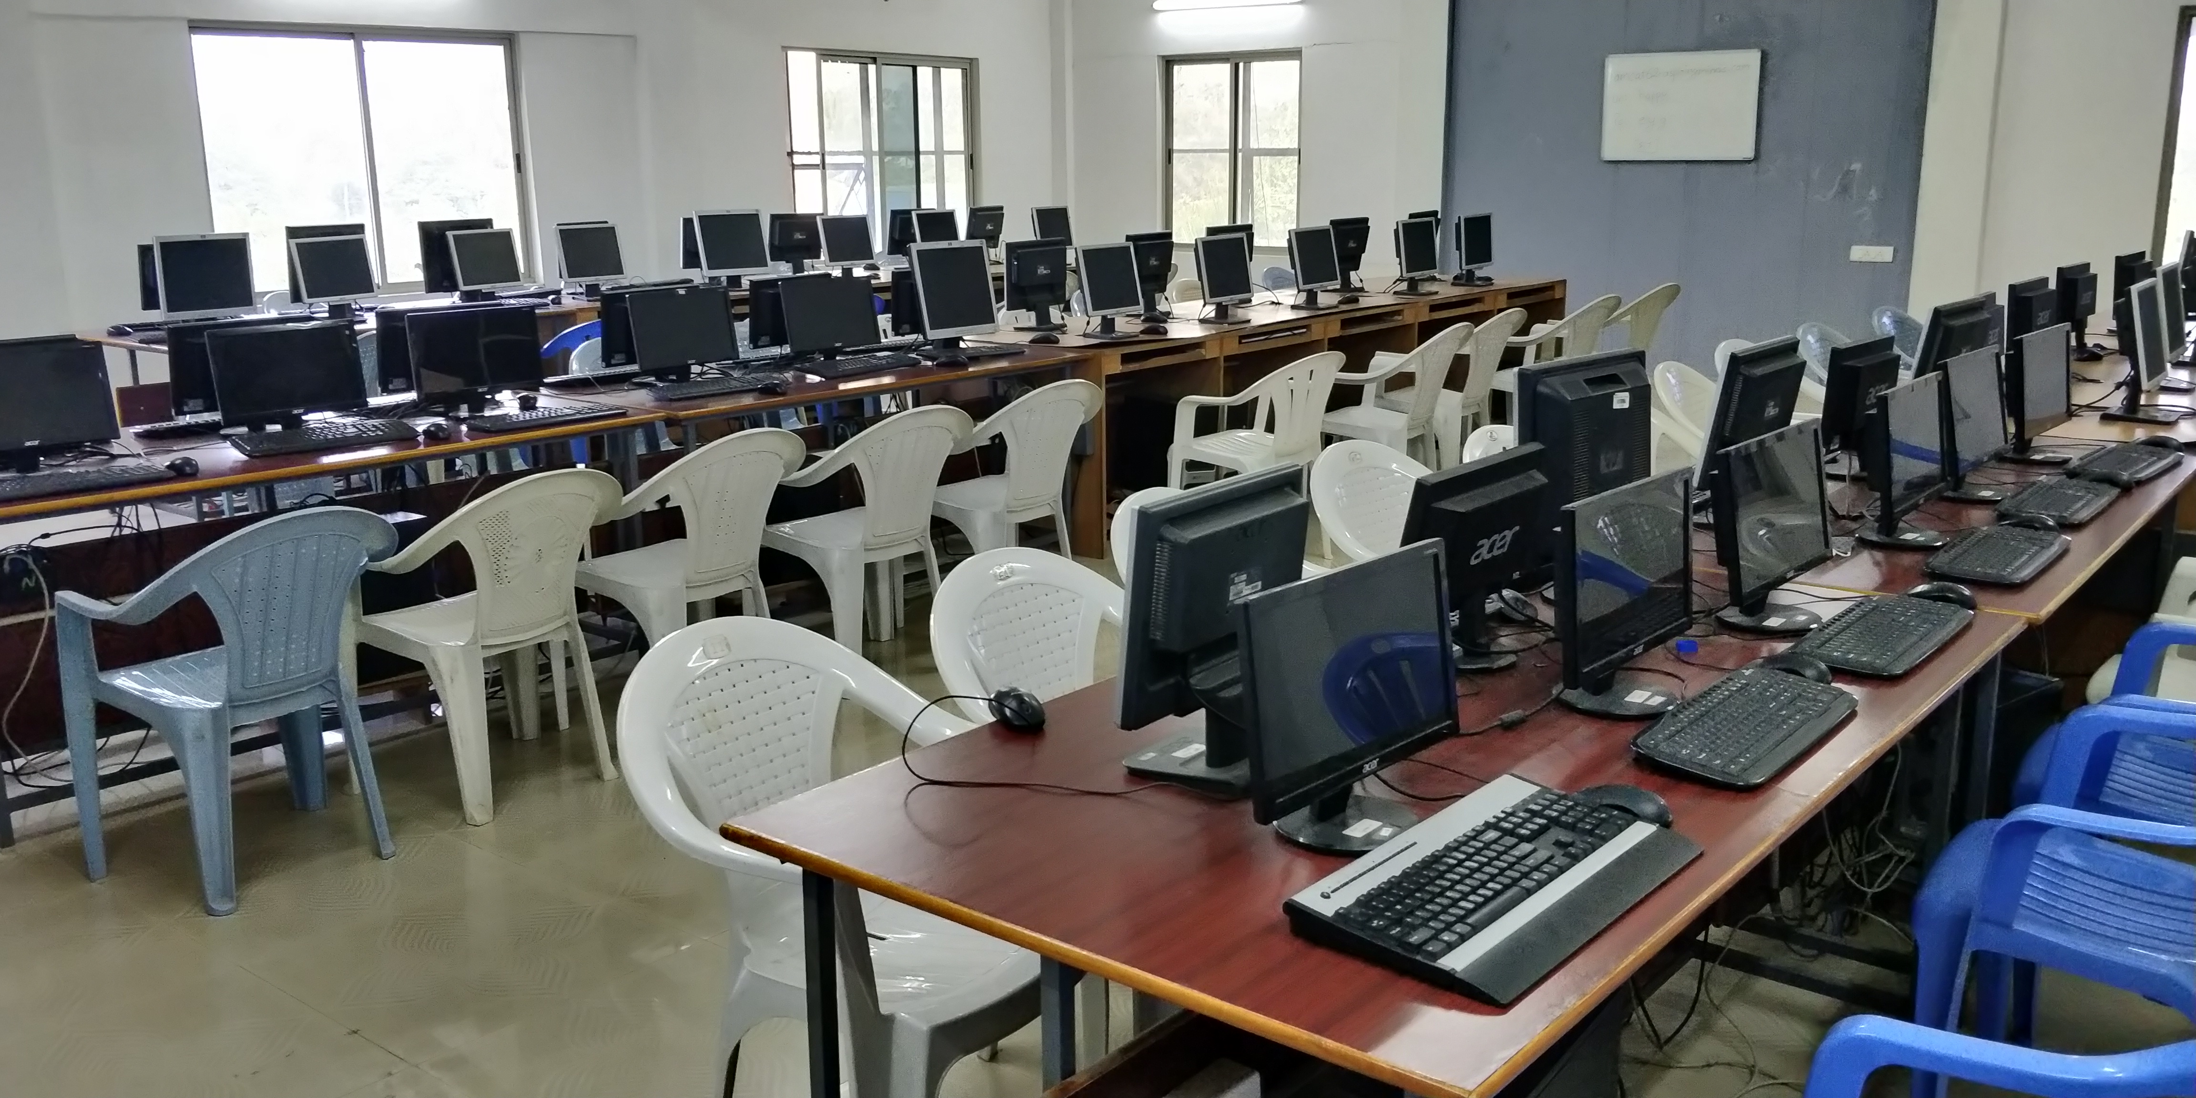
Computer Lab
Facilities
Lighting & Fan
Chairs and Tables
Internet/ LAN Connectivity
Magnetic Whiteboard
Portable Projector
Description | Nos.
Computers | 60
Printers | 2
Name | Location | Carpet Area in Sq.M. | Seating Capacity
Computer Lab | Academic Building | 152 | 60

Slide 26
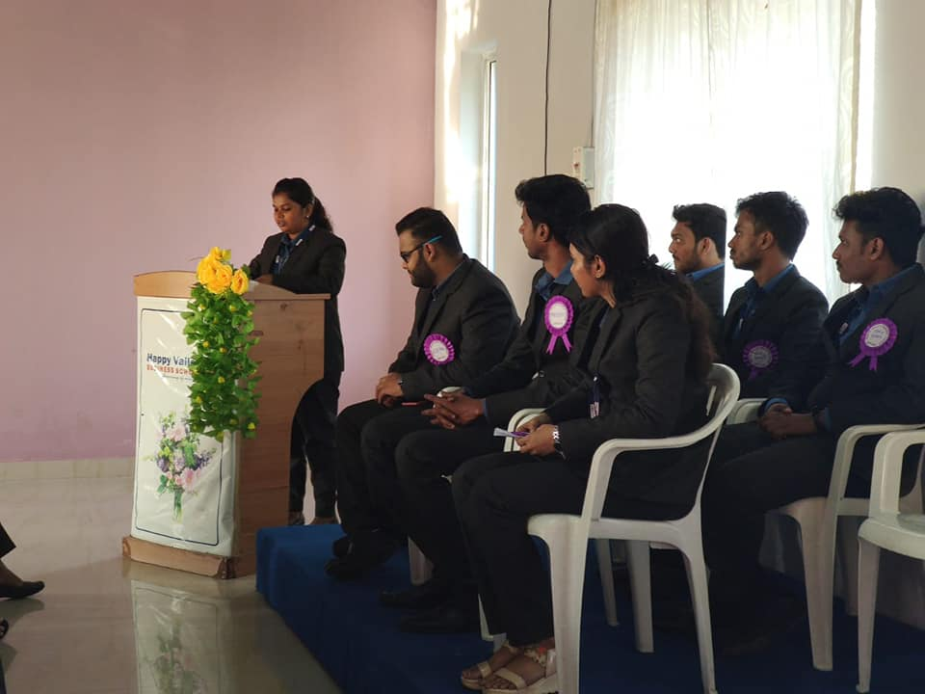
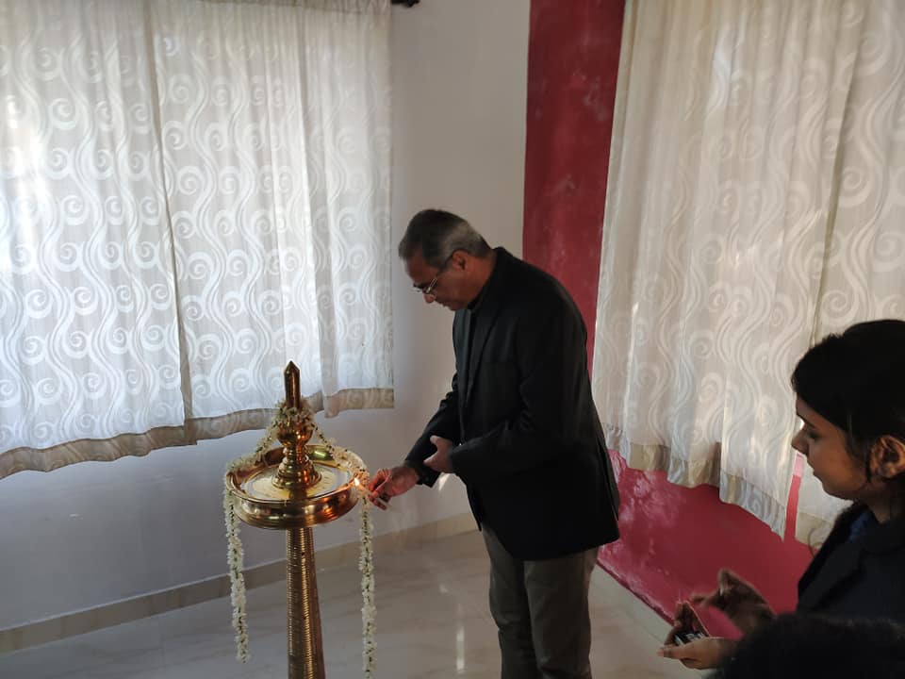
Other Classrooms
Features
Tiles
Audio Facility
Lighting & Fan
Chairs
Magnetic whiteboard
Podium
Name | Room Location | Carpet Area in Sq.M. | Seating Capacity
Activity Room | Library Building | 80 | 60
Centre for Excellence | Library Building | 70 | 50

Slide 27
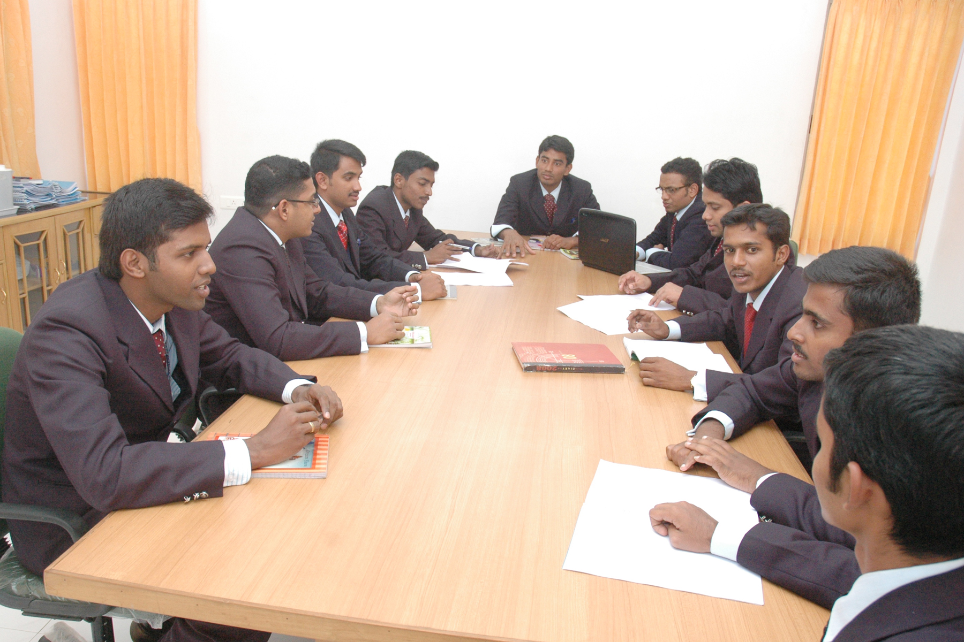
Conference Room

Slide 28
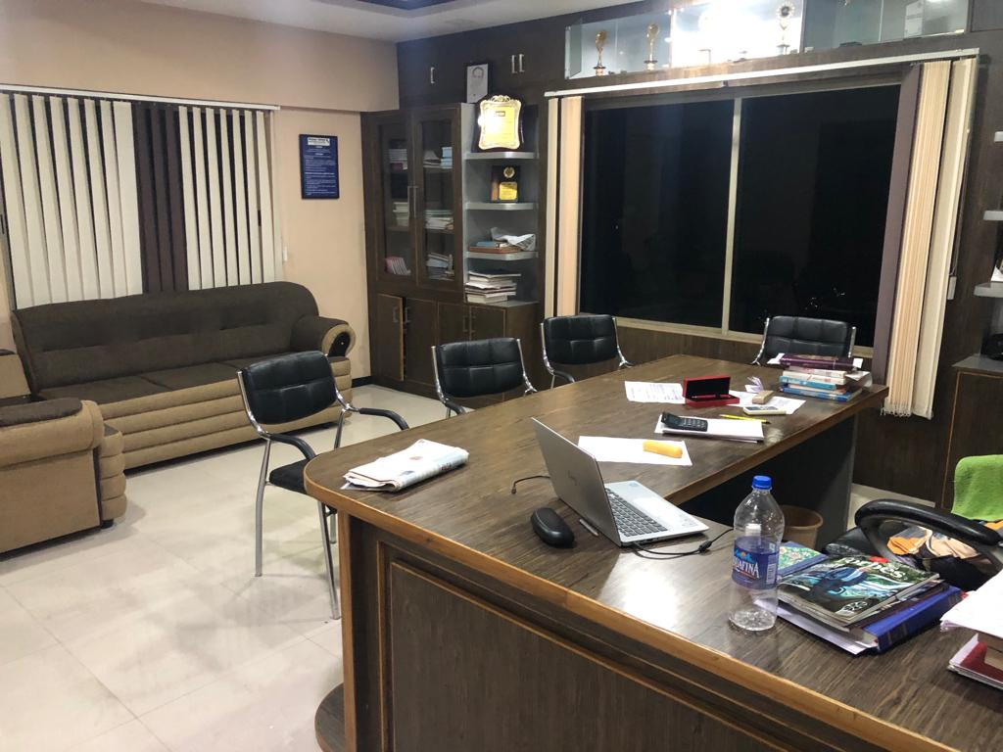

Slide 29
CEO’s OFFICE

Slide 30
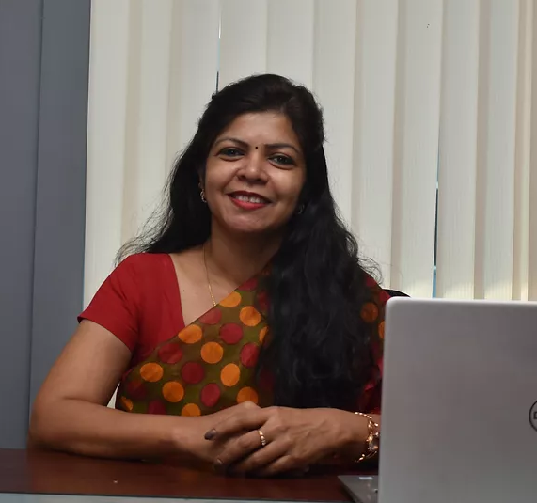
Principal Room
Facilities
Air Condition
LED Lights and Fan
Sofa, Chairs and Table
Official Meetings
Name | Location | Carpet Area in Sq.M. | Seating Capacity
Principal Room | Academic Building | 17 | 4-8

Slide 31
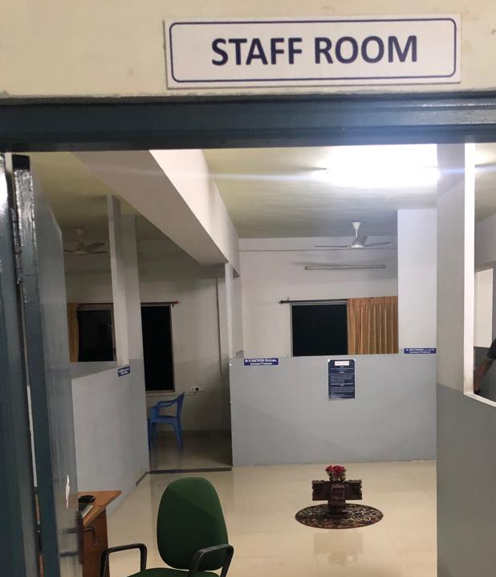
Faculty Rooms

Slide 32
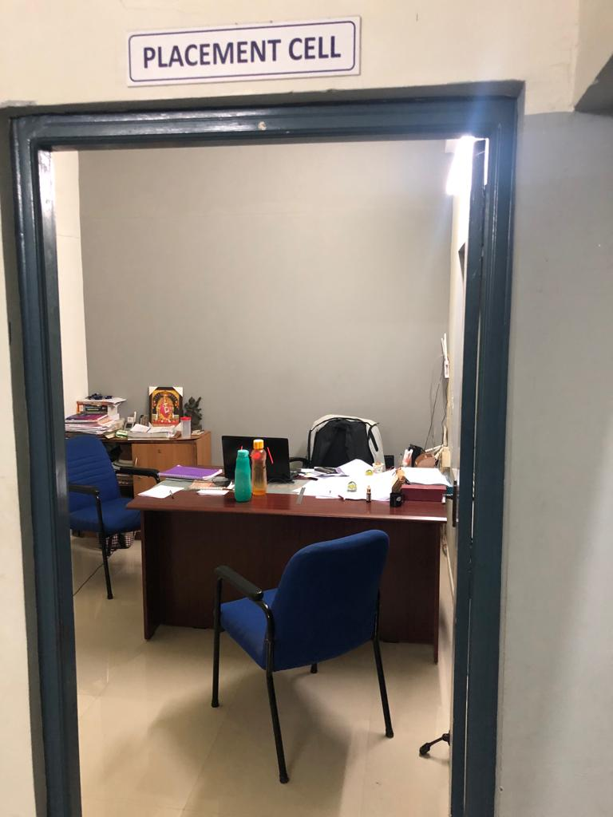
Placement Room

Slide 33
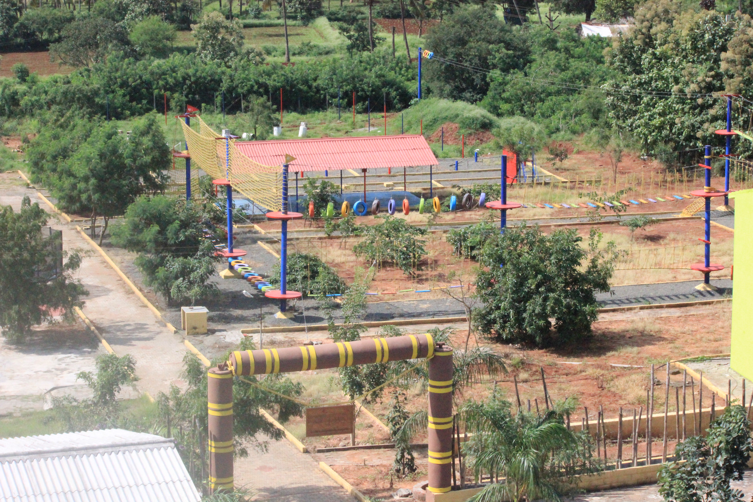
Outbound Activity Centre

Slide 34
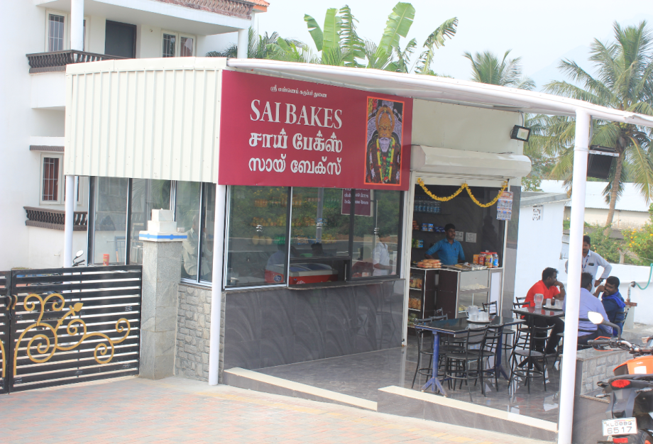
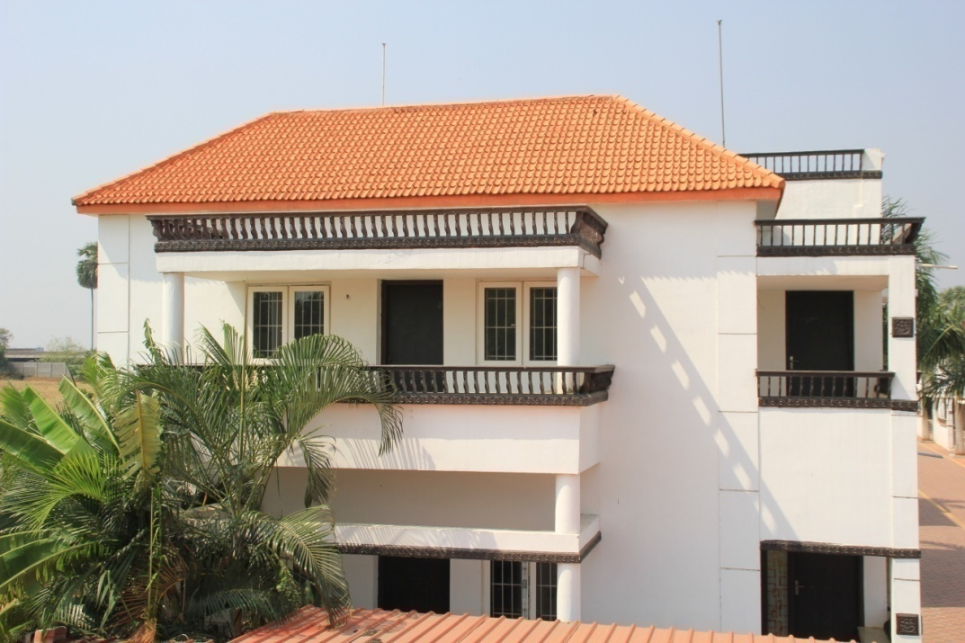
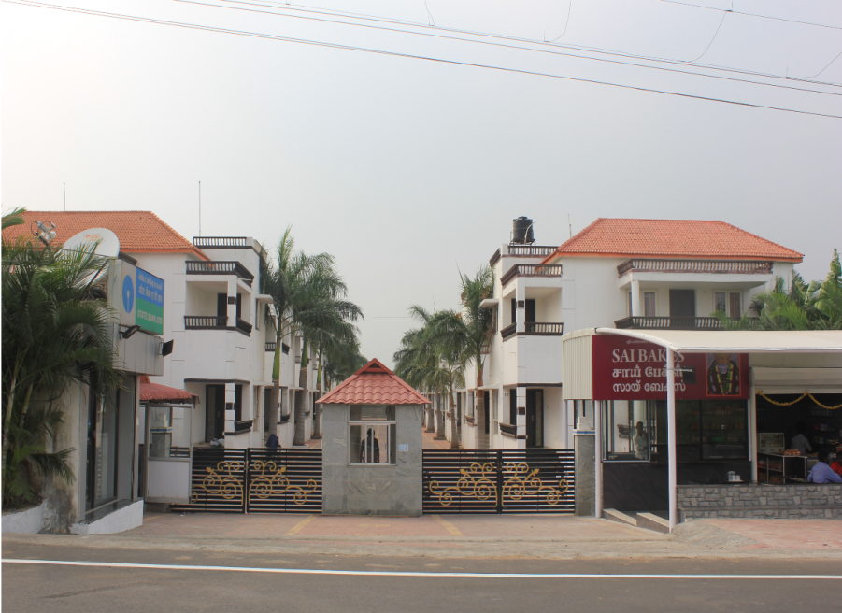
Infrastructure - Boys hostel
The boys hostel has its own cafeteria.
The safety of the students is ensured by CCTV cameras and adequate security personnel.
24 hours uninterrupted Wi-fi connectivity is provided.

Slide 35
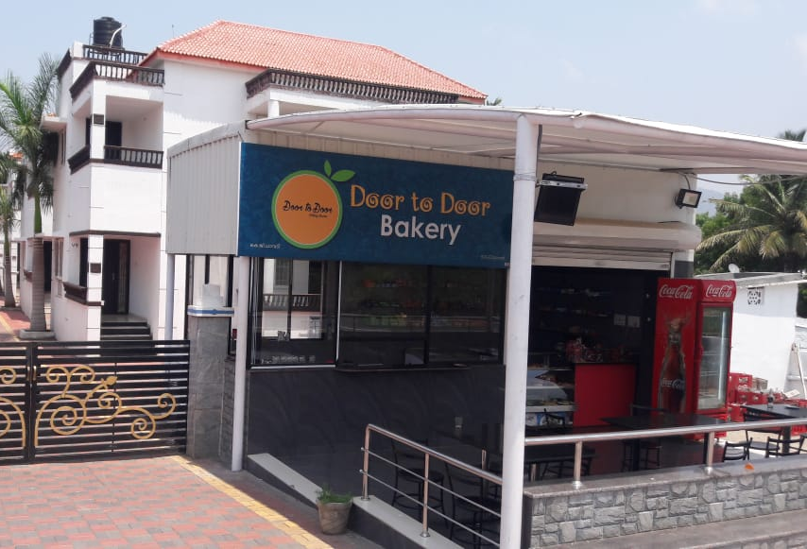
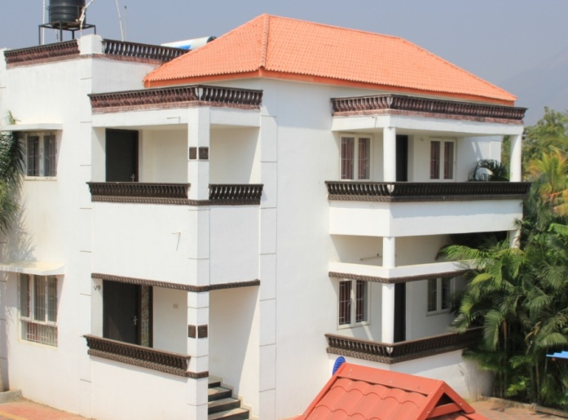
Infrastructure - Boys hostel
ATM facility and a restaurant for inmates and outsiders is available.
A Deputy Warden ensures smooth functioning of the hostel.
Guest house for the alumni, parents, resource persons and corporate guests who visit the campus.

Slide 36
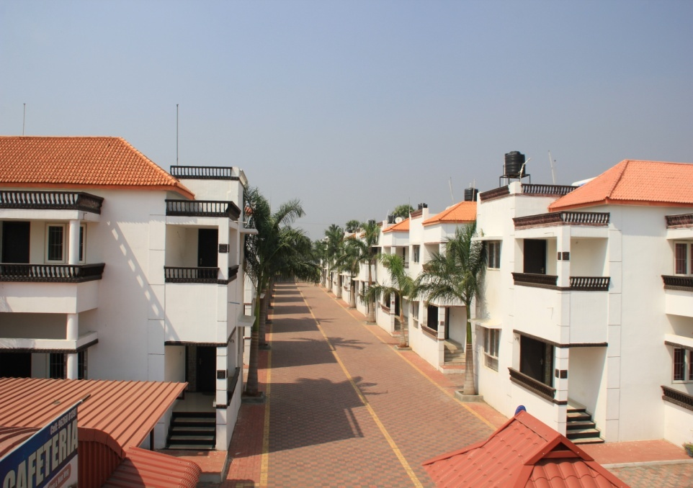
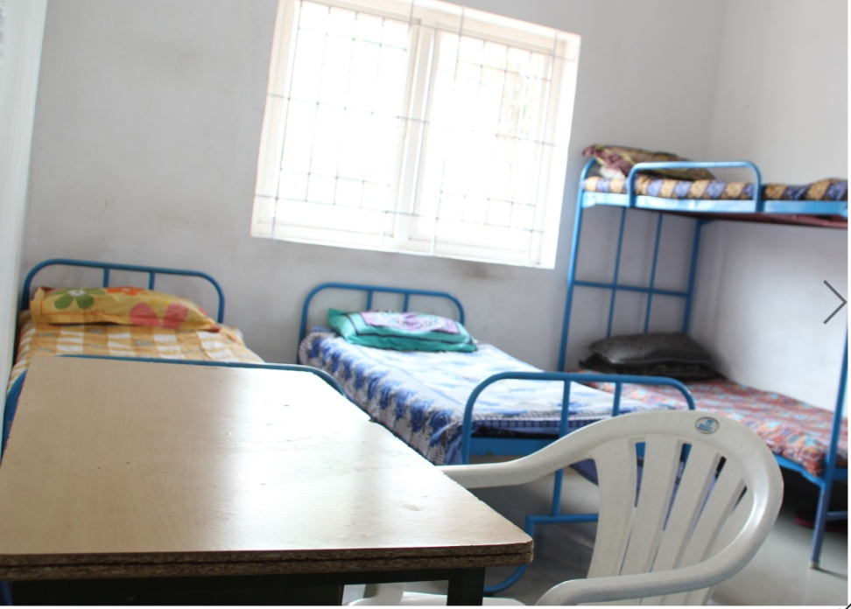
Infrastructure – Boys hostel
16 independent villas are available for male students.
Of the 16 independent villas, fourteen villas are occupied.
R.O drinking water and 24/7 hot water using solar water heaters are available.
Each villa is a 3-BHK facility and with its own parking space.

Slide 37
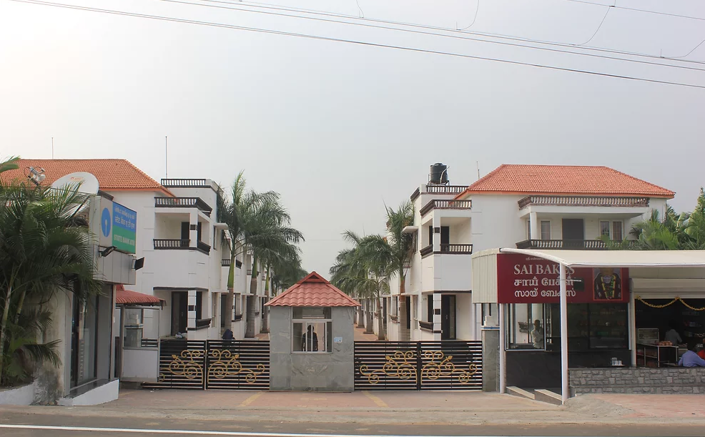
Boys Hostel

Slide 38
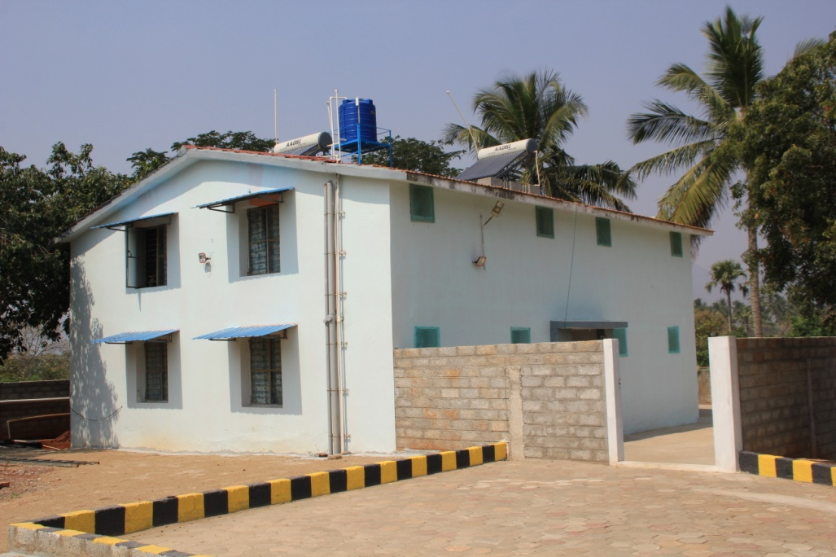
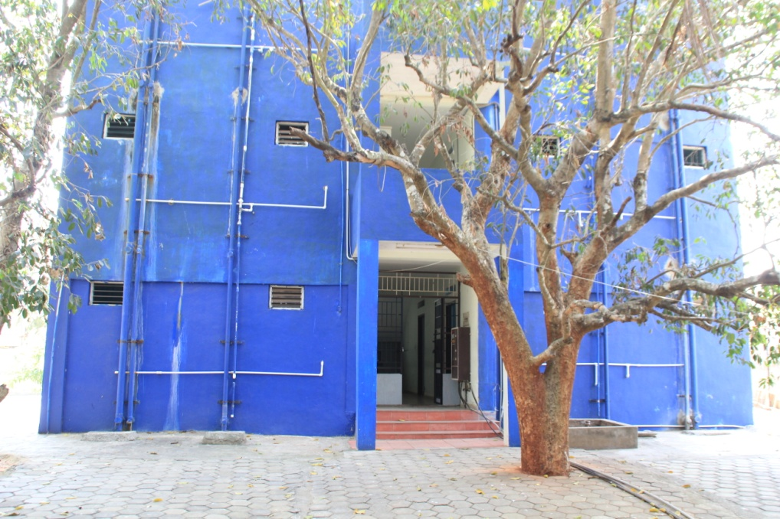
Infrastructure – Girls hostel
Three hostels are dedicated to female students.
All the rooms are spacious and bath attached.
R.O drinking water is available in each hostel
All hostels are fitted with solar water heaters which provides 24/7 hot water facility.

Slide 39
Infrastructure – Girls hostel
The safety of the students is ensured by CCTV cameras and adequate security personnel.
24 hours uninterrupted Wi-fi connectivity is provided.
A Deputy Warden ensures smooth functioning of the hostel.

Slide 40
Gym Facility

Slide 41
Basket Ball Ground

Slide 42
Incubation Centre
Name | Room Location | Carpet Area in Sq.M. | Seating Capacity
Incubation | Library Building | 30 | 20

Slide 43
Infrastructure - Cafeteria
A spacious cafeteria, with adequate seating facility, serves quality food to our students, faculty members and visitors.

Slide 44
STUDENT PARTICIPANTS @HAPPY VALLEY

Slide 45
Students from Batch 01
2007-09 Batch
2008-10 Batch
2009-11 Batch
2010-12 Batch
2011-13 Batch
2012-14 Batch - A
2012-14 Batch - B
2013-15 Batch - A
2013 – 15 Batch - B
2014 -16 Batch - A
2014-16 Batch - B

Slide 46
Students……..contd
2015-17 Batch - A
2015-17 Batch - B
2016-18 Batch - A
2016 – 18 Batch - B
2017 – 19 Batch - A
2018 – 20 Batch - B
2018 – 20 Batch - A
2018 – 20 Batch - B

Slide 47
2019-21 2020-22

Slide 48
STUDENT DIVERSITY

Slide 49
Students Intake & Diversity
Year | Sanctioned Intake | Gender |  | No. of students admitted
 |  |  | Within State |  | Outside State | Other Country | Management Stream | Commerce | Other Streams | Fresher | Experienced*
CAY (2020 – 21) | 120 | M | 10 |  | 34 | 0 | 11 | 26 | 07 | 43 | 1
 |  | F | 5 |  | 33 | 0 | 11 | 11 | 16 | 37 | 1
 | TOTAL |  | 82 |  |  |  | 82 |  |  | 82
CAYm1 (2019 – 20) | 120 | M | 6 |  | 60 | 0 | 21 | 32 | 13 | 64 | 2
 |  | F | 5 |  | 32 | 0 | 12 | 16 | 09 | 37 | 0
 | TOTAL |  | 103 |  |  |  | 103 |  |  | 103
CAYm2 (2018-19) | 120 | M | 13 |  | 62 | 0 | 18 | 34 | 23 | 72 | 3
 |  | F | 3 |  | 42 | 0 | 12 | 23 | 10 | 43 | 2
 | TOTAL |  | 120 |  |  |  | 120 |  |  | 120
CAYm3 (2017-18) | 120 | M | 5 |  | 63 | 0 | 21 | 33 | 14 | 66 | 2
 |  | F | 3 |  | 49 | 0 | 14 | 30 | 08 | 52 | 0
 | TOTAL |  | 120 |  |  |  | 120 |  |  | 120

Slide 50
ANNA UNIVERSITY CURRICULUM
Regulations | University | Pattern
2007 | Anna University – Coimbatore | Trimester
2009 | Anna University – Coimbatore | Trimester
2013 | Anna University – Chennai | Semester
2017 | Anna University – Chennai | Semester
2021 | Anna University Chennai | Semester

Slide 51
COURSE CURRICULUM

Slide 52
Semester – 1
S.NO | COURSE CODE | COURSE TITLE | CATEGORY | CONTACT PERIODS | L | T | P | C
THEORY
1 | BA 5101 | Economic Analysis for Business | PC | 4 | 4 | 0 | 0 | 4
2 | BA 5102 | Principles of Management | PC | 3 | 3 | 0 | 0 | 3
3 | BA 5103 | Accounting for Management | PC | 4 | 4 | 0 | 0 | 4
4 | BA 5104 | Legal Aspects of Business | PC | 3 | 3 | 0 | 0 | 3
5 | BA 5105 | Organizational Behaviour | PC | 3 | 3 | 0 | 0 | 3
6 | BA 5106 | Statistics for Management | PC | 3 | 3 | 0 | 0 | 3
7 | BA 5107 | Total Quality Management | PC | 3 | 3 | 0 | 0 | 3
PRACTICALS
8 | BA 5111 | Spoken and Written Communication # | EEC | 4 | 0 | 0 | 4 | 2
# No end semester examination required for this course |  |  | TOTAL | 27 | 23 | 0 | 4 | 25

Slide 53
Semester - 2
SEMESTER – II
THEORY
1 | BA 5201 | Applied Operations Research | PC | 3 | 3 | 0 | 0 | 3
2 | BA 5202 | Business Research Methods | PC | 3 | 3 | 0 | 0 | 3
3 | BA 5203 | Financial Management | PC | 3 | 3 | 0 | 0 | 3
4 | BA 5204 | Human Resource Management | PC | 3 | 3 | 0 | 0 | 3
5 | BA 5205 | Information Management | PC | 3 | 3 | 0 | 0 | 3
6 | BA 5206 | Operations Management | PC | 3 | 3 | 0 | 0 | 3
7 | BA 5207 | Marketing Management | PC | 4 | 4 | 0 | 0 | 4
PRACTICALS
8 | BA 5211 | Data Analysis for Business Modelling | EEC | 4 | 0 | 0 | 4 | 2
 |  |  | TOTAL | 26 | 22 | 0 | 4 | 2

Slide 54
SUMMER TRAINING: 4 WEEKS
SUMMER TRAINING: The training report along with the company certificate should be submitted within the two weeks of the reopening date of 3rd semester. The training report should be around 40 pages containing the details of training undergone, the departments wherein he was trained with duration (chronological dairy), along with the type of managerial skills developed during the training. The training report should be sent to the Controller of Examinations by the HoD, through the Principal before the last working day of the 3rd Semester.

Slide 55
Semester - 3
S.NO | COURSE CODE | COURSE TITLE | CATEGORY | CONTACT PERIODS | L | T | P | C
THEORY
1 | BA 5301 | International Business Management | PC | 3 | 3 | 0 | 0 | 3
2 | BA 5302 | Strategic Management | PC | 3 | 3 | 0 | 0 | 3
3 |  | Professional Elective – I *** | PE | 3 | 3 | 0 | 0 | 3
4 |  | Professional Elective – II*** | PE | 3 | 3 | 0 | 0 | 3
5 |  | Professional Elective – III*** | PE | 3 | 3 | 0 | 0 | 3
6 |  | Professional Elective – IV*** | PE | 3 | 3 | 0 | 0 | 3
7 |  | Professional Elective – V*** | PE | 3 | 3 | 0 | 0 | 3
8 |  | Professional Elective – VI*** | PE | 3 | 3 | 0 | 0 | 3
PRACTICALS
9 | BA 5311 | Summer Training | EEC | 2 | 0 | 0 | 2 | 1
***Chosen electives should be from two streams of management of three electives each. |  |  | TOTAL | 26 | 24 | 0 | 2 | 25

Slide 56
Semester - 4
SEMESTER – IV
S.NO | COURSE CODE | COURSE TITLE | CATEGORY | CONTACT PERIODS | L | T | P | C
PRACTICALS
1 | BA 5411 | Project Work | EEC | 24 | 0 | 0 | 24 | 12
 |  |  | TOTAL |  | 0 | 0 | 24 | 12

Slide 57
PEO’s
PEO1: To have a thorough understanding of the core aspects of the business.
PEO2: To provide the learners with the management tools to identify, analyze and create business opportunities as well as solve business problems.
PEO3: To prepare them to have a holistic approach towards management functions.
PEO4: To motivate them for continuous learning.
PEO5: To inspire and make them practice ethical standards in business.

Slide 58
PO’s
S.No | Program Outcome
1 | Ability to apply the business acumen gained in practice.
2 | Ability to understand and solve managerial issues.
3 | Ability to communicate and negotiate effectively, to achieve organizational and individual goals.
4 | Ability to upgrade their professional and managerial skills in their workplace.
5 | Ability to explore and reflect about managerial challenges, develop informed managerial decisions in a dynamically unstable environment.
6 | Ability to take up challenging assignments.
7 | Ability to understand one’s own ability to set achievable targets and complete them.
8 | Ability to pursue lifelong learning
9 | To have a fulfilling business career

Slide 59
Validation of CO-PO Mapping
Course Outcome
Course Outcome mapping with Programme Outcome
Setting the CO-PO mapping with Weight-age
Setting CO Measurement through Assessment
Assessment
CO Attainment Table
PO Attainment table

Slide 60
PO – Assessment Process
PO Assessment
Direct Assesment (80%)
Continuous Internal Assessment (20%)
End semester examination (80%)
Indirect Assessment (20%)

Slide 61
CO – Assessment Process
Co Assessment
Internal Assessment
(20% Weightage)
University Assessment
(80% Weightage)

Slide 62
Rubrics – Internal Assessment
Assessment Methods | Attainment Levels
Internal Assessment | Level 1 | 40% of students scoring more than 60% marks in internal assessment tools
 | Level 2 | 50% of students scoring more than 60% marks in internal assessment tools
 | Level 3 | 60% of students scoring more than 60% marks in internal assessment tools

Slide 63
Rubrics – External Assessment
Assessment Methods | Attainment Levels
University (External) Assessment | Level 1 | 40% of students scoring more than 50% marks in internal assessment tools
 | Level 2 | 50% of students scoring more than 50% marks in internal assessment tools
 | Level 3 | 60% of students scoring more than 50% marks in internal assessment tools

Slide 64
CO attainment and Gap Analysis
Couse Outcome | Attainment Level for last year | Target for current exam | Attainment Level of current year | Gap | Gap Analysis
CO1
CO2
CO3
CO4
CO5

Slide 65
PO attainment analysis
POs | Target Level | Attainment Level | Observation
PO1. Ability to apply the business acumen gained in practice.
PO1
Continued till CO9
Action 1:
Action 2:

Slide 66
Gap Analysis
Program Outcome | Requirement | Actual | Gap | Action taken
PO1 | Theoretical knowledge with practical exposure | Curriculum and syllabus have the scope to cover only theoretical knowledge | Syllabus and curriculum ignore the requirement of practical knowledge | Ably addressed by the institution through various means of practical exposure.
PO2 | Learning and application of knowledge without replication Business constraints are not well defined | Theoretical classes provide an analytical bent of mind, which helps in solving problems having definite solutions | Failure in customization of knowledge & bringing out appropriate solutions. | Real life business scenarios are brought into the classroom & students analyze it thoroughly. Board games help simulate real world problems & students strategize to solve corporate issues.
PO3 | In the quid pro quo system, students need to know the art of negotiation. | Spoken and written communication course is offered as a part of the syllabus | Art of negotiation skills | Negotiation games are conducted.

Slide 67
Gap Analysis
Program Outcome | Requirement | Actual | Gap | Action taken
PO4 | Student should be competent enough to be effective in his profession | More than 10 courses give a student competence to upgrade professional and managerial skills | Requires ethics, humanitarianism, responsibility, honesty & nobility in his climb up the corporate ladder | Coffee pot meetings with the corporate leaders help students learn such virtues. ISR activities are eye openers for students to understand the suffering of the poor & under privileged.
PO5 | Knowledge on contemporary issues & preparedness for the future. | Concepts are relevant for any period, but old solutions become redundant in the dynamic world | Real-time updation & new thinking becomes important & urgent. | Current News Analysis, GD’s on current topics and debates are regularly conducted to keep the students updated.
PO6 | Armed with ideas & undying enthusiasm | Summer internships & project, apart from a few courses give exposure to students. | Ability & enthusiasm to be tested by creating opportunities to exhibit these qualities | Team building games, creativity workshops, Personality Reengineering workshops, Outbound training programs.

Slide 68
Gap Analysis
Program Outcome | Requirement | Actual | Gap | Action taken
PO7 | Identification of natural talent, acquired skills, areas of unrelenting interest | Course work to help the student align his abilities with interest. | Opportunities to be given to understand one’s strength & weakness, potential & limitations, talent, aligning of skills and area of interest. | Goal setting workshop Outbound training program
PO8 | To make students realize that knowledge is exciting | Integration of past, present & future developments are discussed to instill interest | Requires more personal experience | Book reading, book reviews, watching TED videos, participation in programs like ‘Youth and Truth’
PO9 | Motivation to pursue higher order needs | Higher order needs are not emphasized in the regular course work | At times students suffer Niagara syndrome | Re-orientation, Guest lectures, training, workshops, national & international visits.

Slide 69
Process framework @ Happy Valley
Enablers
Process
Outcomes
Infrastructure
Library
Admission
Faculty
Global input
Industry interface
Academics
Placement readiness
Research and Development
Faculty publications
Leadership & Governance
MDP’s, consultancy and Industry interaction
Consultancy
Faculty appraisal and promotion policy
Internationalization linkage process
Staff appraisal
Clubs
Academic results
Placements
Eligible corporate citizens
Values and ethics
Entrepreneurship & Job creation
Industry Interaction
MDP’s
International connectivity
Research
Stakeholders satisfaction.
Responsible citizens to the
Society
FEEDBACK

Slide 70
Faculty Initiatives
Collaborative Learning
Focussed Learning
Independent Learning
Interactive Learning
Life-skills Learning
Flipped Classroom activities
Industrial Visits
A Day with HR
Coffeepot Meetings
Business Simulation Games
Roleplays
Case Studies
Situation Analysis
Team Building Games
Small Talks
Current News Analysis
Story Telling
PRE Workshops
Creativity Workshops
I Can Obstacle Courses
Club Activities
Carnivals
Micro Business Start-ups
Industrial & International Visits
Advanced Excel
Tally
Business Communications
Cases
Mock Trading

Slide 71
COFFEE POT @STAR HOTELS

Slide 72
GROUP DISCUSSIONS

Slide 73
GUEST LECTURES

Slide 74
INDUSTRIAL VISITS

Slide 75
OUTBOUND TRAINING

Slide 76
PAID INTERNSHIPS- SBI

Slide 77
Experiential Learning

Slide 78
PRE-PERSONALITY RE-ENGINEERING

Slide 79
SEMINARS

Slide 80
FLIP CLASS

Slide 81
A DAY WITH HR

Slide 82
COMMUNITY SERVICE

Slide 83
SUMMER INTERNSHIPS

Slide 84
PAID INTERNSHIPS

Slide 85
Short Term Courses for students- – Sample List
S.NO | BATCH | COURSE OFFERED/WORKSHOP | PARTNERSHIP INSTITUTION | COURSE DURATION
1 | 2020 - 2022 | Statistical Analysis through Excel | Excel Through Excel, Bengaluru | 15 Hours
2 | 2020 - 2022 | Word Essentials for Managers | Excel Through Excel, Bengaluru | 15 Hours
3 | 2019 - 2021 | Excel Essentials at Work | Excel Through Excel, Bengaluru | 30 Hours
4 | 2019 - 2021 | Business Communication for Career Development | VR Carreerz, Bengaluru | 10 Hours
5 | 2018 - 2020 | Business Communication for Career Development | VR Carreerz, Bengaluru | 10 Hours

Slide 86
HAPPY VALLEY KNOWLEDGE SERIES (YOUTUBE CHANNEL)

Slide 87
Yi @ HAPPY VALLEY!

Slide 88
NIPM HAPPY VALLEY CHAPTER

Slide 89
ROTARACT CLUB OF HAPPY VALLEY

Slide 90
EXTENSION ACTIVITIES

Slide 91
Placement, Higher Studies and Entrepreneurship
Item | CAYm1 (2019-20) | CAYm2 (2018-19) | CAYm3 (2017 - 18)
No. of students placed in companies or Government Sector (x) | 74 | 71 | 83
No. of students pursuing Ph.D. / Higher Studies (y) | 4 | 2 | 1
No. of students turned entrepreneur (In the areas related to management discipline) (z) | 10 | 8 | 5
x + y + z = | 88 | 81 | 89
Placement Index: (x + y + z )/N | 88/119 = 0.7394 | 81/111 = 0.7297 | 89/119 = 0.7478
Average Placement= (P1 + P2 + P3)/3 | 2.2169/3 = 0.7389
Assessment Points = 40 × average placement | 40 x 0.7389 = 29.556

Slide 92
FACULTY @ HAPPY VALLEY

Slide 93
Dr.T.BINA, PRINCIPAL
BE, MBA, M.Phil, Ph.D
25 Years of teaching experience
UGC, SLET ELIGIBILITY TEST For lectureship
MEMBER –CII Educational panel
Active in WOMENS EMPOWERMENT CELLS&
ROTARY

Slide 94
FACULTY TEAM
Cumulative work experience = 203 years

Slide 95
List of Faculty with qualification & years of experience
S. No. | Name of the Faculty | Designation | Degree (Highest Degree) | University | Award of Highest Degree | Date of Joining | Area of Specialization | Academics | Industry | Total
1 | Dr.T.Bina | Principal | Ph.D | Avinashilingam University | 2007 | August 01, 2007 | Marketing | 24Y 4M | - | 24Y 4M
2 | Dr.C.Kanagaraj | Professor | Ph.D | Bharathiar University | 2006 | September 01, 2007 | Economics | 22Y 7M | 10Y 11M | 33Y 6M
3 | Dr.G.Thiruvasagam | Associate Professor | Ph.D | Periyar University | 2013 | June 21, 2008 | Human Resources | 21Y | 1Y | 22Y
4 | Mrs.A.Indira | Associate Professor | M.Phil | Mother Teresa University | 2007 | August 01, 2007 | Finance | 21Y | - | 21Y
5 | Dr.R.Vishal Kumar | Associate Professor | Ph.D | Anna University | 2017 | July 14, 2008 | Marketing | 16Y | - | 16Y
6 | Dr.S.Muthiah | Associate Professor | Ph.D | Bharathiar University | 2018 | January 02, 2008 | Finance | 13Y | 7Y | 20Y
7 | Dr.P.Shanmughapriya | Assistant Professor | Ph.D | Anna University | 2017 | May 04, 2009 | Finance | 14Y | - | 14Y
8 | Mr.K.Sampath Kumar | Assistant Professor | MBA | Bharathiar University | 2002 | March 28, 2014 | Marketing | 16Y | - | 16Y
9 | Mr.A.Arun Prakash | Assistant Professor | MBA | Anna University | 2008 | December 12, 2012 | Finance | 8Y | 5Y | 13Y
10 | Mr.A.Manoj Kumar | Assistant Professor | MBA | Anna University | 2011 | June 18, 2012 | Human Resources | 8Y | 11M | 8Y 11M
11 | Ms.A.Aaziya | Assistant Professor | MBA | Bharathiar University | 2010 | July 1, 2014 | Marketing | 9Y | - | 9Y
12 | Mr.Lors Porseena.M | Assistant Professor | MBA | Anna University | 2010 | July 20, 2015 | Human Resources | 10Y | - | 10Y
13 | Mr. Santhosh Raja R | Assistant Professor | MBA | Anna University | 2012 | June 25, 2019 | Finance | 8Y | - | 8Y

Slide 96
Faculty Qualification
 | Required Faculty | Faculty Members with Ph.D Qualification | % of Faculty Members with Ph.D Qualification
CAY (2020-21) | 12 | 6 | 50
CAY 9(2019-20) | 12 | 6 | 50
CAY+ (2018-19) | 12 | 6 | 50

Slide 97
Proportion of PhD holders

Slide 98
Faculty Student Ratio
Year | CAY (2020-21) | CAYm1 (2019-20) | CAYm2 (2018-19)
P1.1 | 120 | 120 | 120
P1.2 | 120 | 120 | 120
Total No. of Students in the Department (S) | 240 | 240 | 240
No. of Faculty in the Department (F) | 13 | 14 | 14
Student Faculty Ratio (SFR) | 18.46 | 17.14 | 17.14
AVERAGE SFR | 17.58

Slide 99
Faculty Retention
Year | No. of Regular faculty | No. of Faculty retained | Name of the Faculty left | Date of Leaving | Name Faculty newly joined | Date of Joining | Percentage
CAY (2020-21) | 14 | 13 | Mr. D.Prashanth | 08/10/2020 | - | - | 13/14=92.85
CAY m1 (2019-20) | 14 | 13 | Mr.T Sivagnana Selvakumar | 03/06/2019 | Mr. Santhosh Raja | 25/06/2019 | 13/14=92.85
CAYm2 (2018 – 19) | 14 | 14 | Nil | NA | - | - | 14/14= 100
Average 95.2

Slide 100
Academic Research – Sample List
S. No | Title of paper | Name of the author/s | Name of the Journal | Year of Publication | ISBN/ISSN Number
1 | Impact of Influencer Marketing in Brands | Ms.J.R.Mary Sheela , Dr.T.Bina | Nehru Journal of Management and Research | 2020 | 2230-7974
2 | Consumer Buying Behaviour of Millennial - The Future of Online Retails and Offline Retail in India | Dr.T.Bina | International Journal of Innovation Science and Research | 2020 | 2319-9369
3 | A study on Stress Management Strategies of Students | Mr.A.Manoj Kumar | Asian Journal of Science and Technology | 2020 | 0976-3376
4 | A Study on the customer preference towards online streaming services | Mr.K.Sampath Kumar | International Journal of Recent Advance in Multi-Disciplinary Research | 2020 | 2350-0743
5 | Predictive analysis of the factors that influence customers’ preference for online platforms while buying insurance policy | Ms. A.Indira | International Journal of Management and Social Sciences | 2018 | Volume – 8, No.1.2 (2018) – IJMSS – SEP 8(1.2) Special Issue 2018
6 | College students’ banking habit in Coimbatore District with reference to the usage of digital payment systems | Ms. A.Indira | International Journal of Scientific Research and Review | 2018 | Volume – VII, Sept -2018, ISSN No: 2279 – 543x
7 | Assessing Financial Literacy Levels of Banking and IT/Ites Employees | Dr.P.Shanmugha Priya, Mr.R.Vishal Kumar | International Journal of Engineering and Advanced Technology | 2019 | 2249-8958, Volume - 8, Issue - 5, June 2019

Slide 101
Online MooC Courses
S.No | Faculty Name | Course Name | University | Date
1 | Indira A | Excel Skills for Business | Coursera – Macquaire University, Australia | Nov 2020
2 | Dr T Bina | Digital Analytics for Marketing Professionals – Marketing Analytics in Theory | Coursera – Illinois University | September 2020
3 | K Sampath Kumar | Introduction to Personal Branding | Coursera – University of Virginia | March 2020
4 | K Sampath Kumar | Introduction to Personal Branding | Coursera – University of Virginia | March 2020

Slide 102
Faculty as a Consultant - Sample List
S. No. | Name of the Faculty Member as Consultant | Name of the Organisation | Duration | Area of Consultancy
1 | Dr C. Kanagaraj – CEO, Dr T.Bina – Principal & Mr Arun Chandran Assistant Professor | A proposed Dental Hospital in Angamaly, Kerala. | 3 Months | Market Potential & Competitor Analysis
2 | Dr Vishal, Mr Manoj, Mr Santosh, Mr Lors, Mr Arun Chandran | Teknoturf Info Services Pvt Ltd, | 3 months | Content Writing
3 | Dr C. Kanagaraj – CEO & Dr T.Bina – Principal | CREDAI, Coimbatore | 2 Months | Primary and Secondary Research
5 | Dr.T. Bina | Niswin Enterprises, Old Damu Nagar, Puliakulam, Coimbatore, Tamil Nadu 641045 | One week | Research on market potential for refined flour and addictives

Slide 103
FDP

Slide 104
FACULTY AS EXPERT/JUDGE/RESOURCE PERSON

Slide 105
MANAGEMENT DEVELOPMENT PROGRAMMES

Slide 106
List of MoU’s
S.No | Name of the Company/College/Universities (International and National) | Signed on | Validity in Years | Purpose of the MoU
1 | FNF India Private Ltd, Bangalore | 17.08.2021 | 1 Year | Placements
2 | Laghu Udyog Bharti Coimbatore Chapter | 15.09.2020 | 3 Years | Market Potential Surveys, Creating platforms to share best practices in various industries and develop application models
3 | VR CAREERZ (10th street, Anna Nagar, Pattambiram, Chennai - 72) | 29.01.2020 | Permanent (Valid Until Termination) | Placement Training and Placements
4 | LINCOLN UNIVERSTY COLLEGE (12, 13 Jalan SS 6/12. Kelana Jaya, 47301, Petaling Jaya, Selangor, Malaysia) (Sample Proofs attached) | 30.12.2019 | 5 years | Student Enrichment Program for our students through conducting Workshops, Seminars, etc
5 | INCUBE EDIBLE OIL INDUSTRIES (10-02 Jalan Tasek 61, Banadar Seri Alam, Johor, Malaysia) | 22.03.2019 | 5 years | Student Project and Internship, Industrial Visit, Guest Lectures, Sabbaticals, Research

Slide 107
List of MoU’s
S.No | Name of the Company/College/Universities (International and National) | Signed on | Validity in Years | Purpose of the MoU
6 | WHITE DIAMOND STUDIO (Johor Bahru, Malaysia) | 24.02.2018 | 5 years | Student Project and Internship, Industrial Visit, Guest Lectures, Sabbaticals, Research
7 | ST.JOSEPH’S COLLEGE (Irinjalakuda, Thrissur Dt, Kerala, 680121) | 15.02.2018 | 3 years | Student Exchange Program, Faculty Exchange Program, Research Surveys, ISR activities
8 | SKY WING (112, 2nd Floor, Jalan Pudu, Bukit Bintang, 55100 Kuala Lumpur, Malaysia) | 27.01.2018 | 5 years | Student Project and Internship, Industrial Visit, Guest Lectures, Sabbaticals, Research
9 | M.E.S PONNANI COLLEGE (Ponnani, Malappuram Dt, Keralas) | 25.01.2018 | 3 years | Student Exchange Program, Faculty Exchange Program, Research Surveys, ISR activities
10 | RELIANCE JIO INFOCOMM LTD (RJIL) 222, Nariman Point, Mumbai | 01.04.2016 | 3 Years | To install, commission, operate and maintain various telecom equipment and to use common areas, ducts roof tops, etc.,

Slide 108
List of MoU’s
S.No | Name of the Company/College/Universities (International and National) | Signed on | Validity in Years | Purpose of the MoU
11 | MARK 1 EVENTS (TV Swamy Road, R.S.Puram, Coimbatore) | 14.07.2014 | 5 Years | To Provide Job Specific training, internship and project work, training and consultancy, R&D activities.
12 | GK MANAGEMENT SERVICES LIMITED (GKM Towers, 142 Alagesan Road, Coimbatore - 11) | 14 Oct 2010 and Renewed on 08.07.2018 | 5 years | To Provide Job Specific training, internship and project work, training and consultancy, R&D activities.
13 | BHARATHIAR UNIVERSITY Coimbatore | 09.02.2011 | 3 years | CPOP program on Logistics and Shipping

Slide 109
MoU with Laghu Udyog Bharti (LUB), Coimbatore.

Slide 110
Global Input – Student’s International Visit to Malaysia
Global Input – Student’s International visit

Slide 111
Global Input – MoU- Incube Edible Oil Industries, Malaysia
Our MoU partners outside India are of immense help in providing international exposure to our students.

Slide 112
MoU- LINCOLN UNIVERSITY, MALAYSIA

Slide 113
MoU with Lincoln University, Malaysia

Slide 114
Global Input – Guest lectures by Mr.Adrian Wood, IB Consultant, Australia
Professionals in the area of management from abroad visit our campus and interact with our students.
International journals also help our students to acquire a global perspective.

Slide 115
WITH Dr.JEREMY JONES, UNIVERSITY OF CANBERRA, AUSTRALIA

Slide 116
With Mr.Visakh Menon, Brand consultant, New York

Slide 117
ALUMNI INTERACTIONS

Slide 118
BEST ALUMNI AWARD

Slide 119
Aspiring to South – up the blue marble (globe) of Business Studies.
True to cartography, with a North on top and South at the bottom we at Happy Valley Business School aspire to be an institution of eminence from the south

Slide 121
THANK YOU
FOR YOUR TIME!

